Slide 1
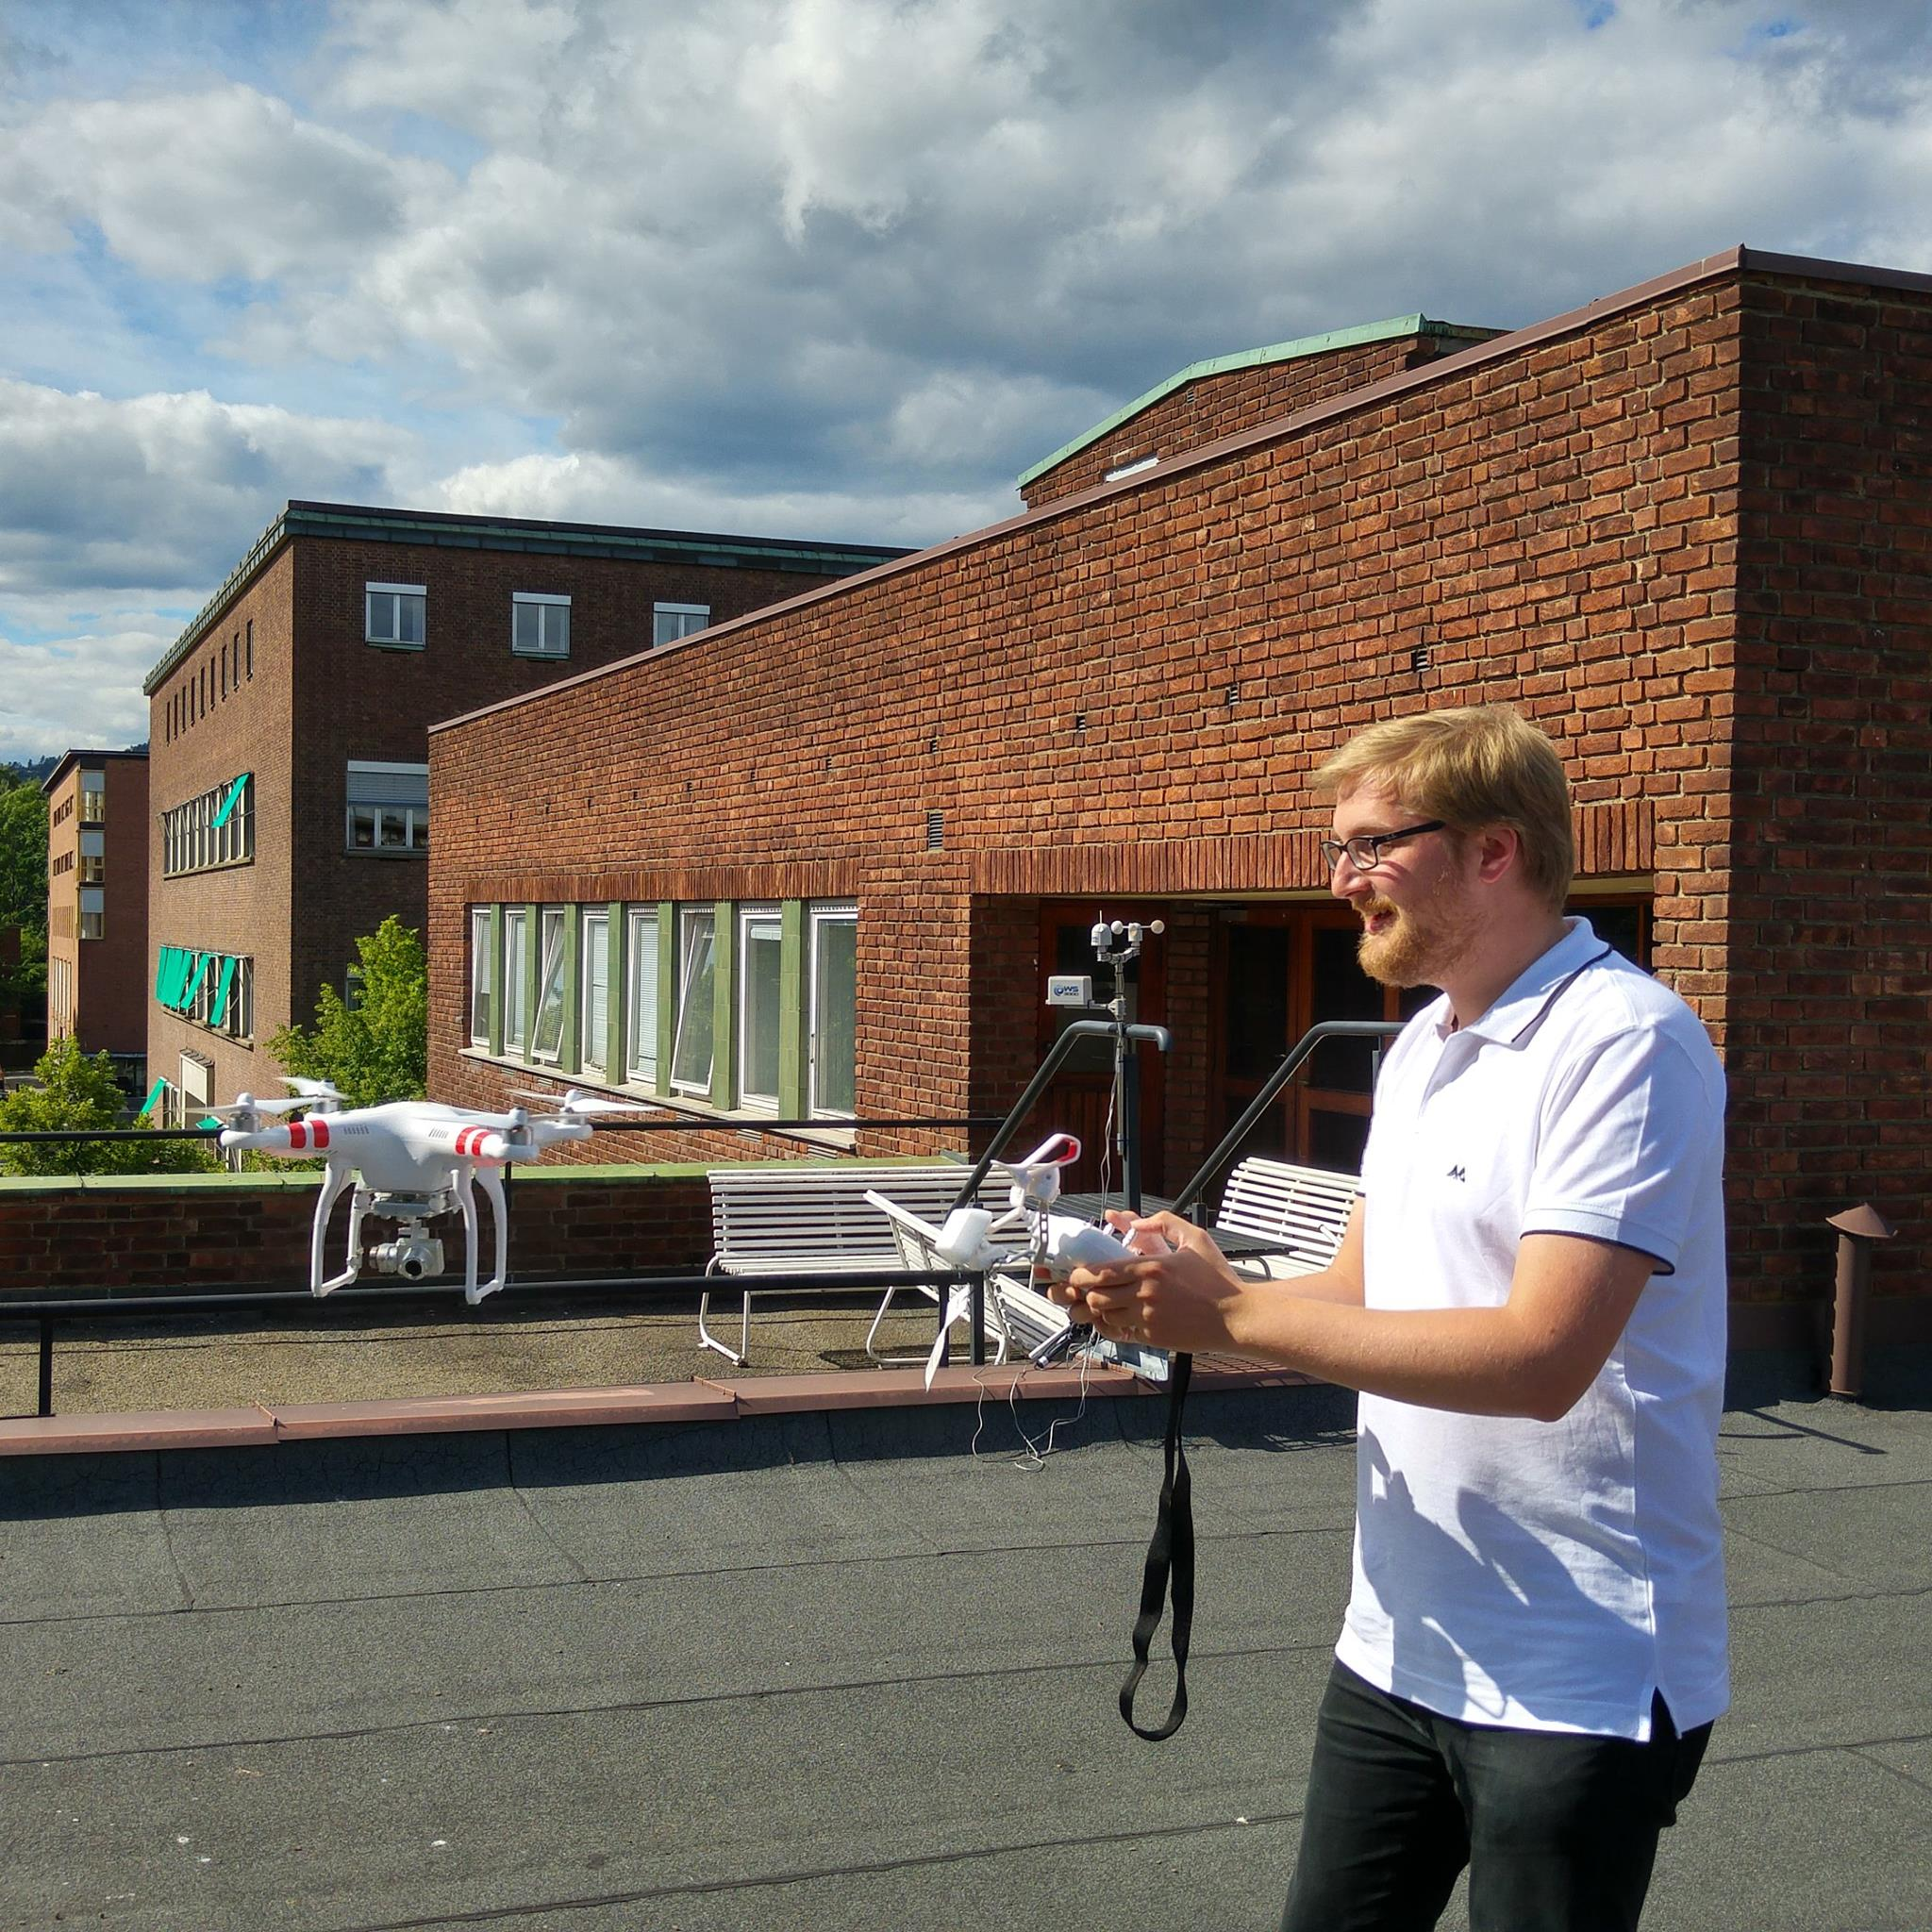
Who am I?
MSc in Engineering from the French Geographical Institute
PhD at UiO Improved measurements of cryospheric processes using advanced photogrammetry, defended in February 2018 →‘’Your raw imagery data isn’t quite as bad as you think it is, you’re just not trying hard enough’’
Research Enginner at UiO, DroneLab manager

Slide 2

Spatial Analysis Data structure Topology
GEO3460 – Geografiske informasjonssystemer (GIS) og geografisk datainnsamling – vår 2025
GEO3460 - Geographical Information Systems (GIS) and Geographical Data Acquisition - spring 2025
Luc Girod (luc.girod@geo.uio.no)
Based on the lectures by Livia Piermattei and Martin Lund

Slide 3
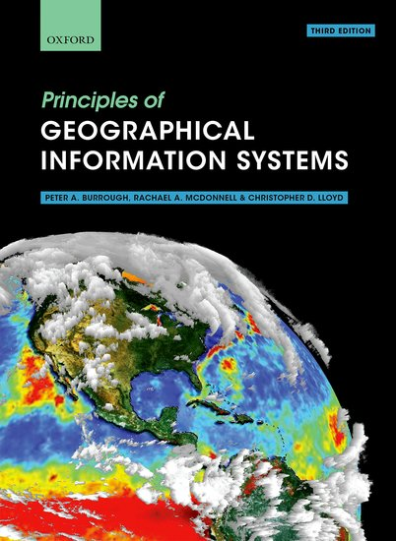
Reference textbook:
“Geographical information systems”

Slide 4

Learning Objectives
Basic concepts for describing GIS data, raster and vector data, their attribute and level of measurement, and the file format.
1
2
3
GIS
Spatial – temporal dimension
What is a GIS
GIS application
Digital representation
of spatial data
Geographic data
Continuous vs discrete data
Raster, Vector & Topology
Attributes
File
Format
Raster
Vector
Software
Today’s topics
Notes:
What you will learn by the end of the lecture
Basic of Geographic information systems (GIS)
Uses for GIS technologies
Raster and vector data
The goal of the lecture is to provide a general overview of the basic term and concept related to GIS and its use.
So first I provide a general introduction to GIS definition, discussing various geographic phenomena and important I will introduce the concept of spatial temporal dimension.
Second, we will discuss the way these phenomena are presented and in general the specific characteristic of geospatial data.
Each section contain a summary and some questions. The questions (exercise) are meant to be a test of understanding of the content of the lectures. They are not practical exercise, for this there is the laboratory.
In between each block I provide you with some questions and at the end of the lecture we will discuss together on the question and we can open the discussion and question on the topics.

Slide 5
GIS
1
2
3
GIS
Spatial – temporal dimension
What is a GIS
GIS application
Digital representation
of spatial data
Geographic data
Continuous vs discrete data
Raster, Vector & Topology
Attributes
File
format
Notes:
Basic of Geographic information systems (GIS)
Uses for GIS technologies
Raster and vector data
The goal of the lecture is to provide a general overview of some of the term concept related to GIS and its use.
So first I provide a general introduction to GIS definition, discussing various geographic phenomena. Second, we will discuss the way these phenomena are presented and in general the specific characteristic of geospatial data.

Slide 6
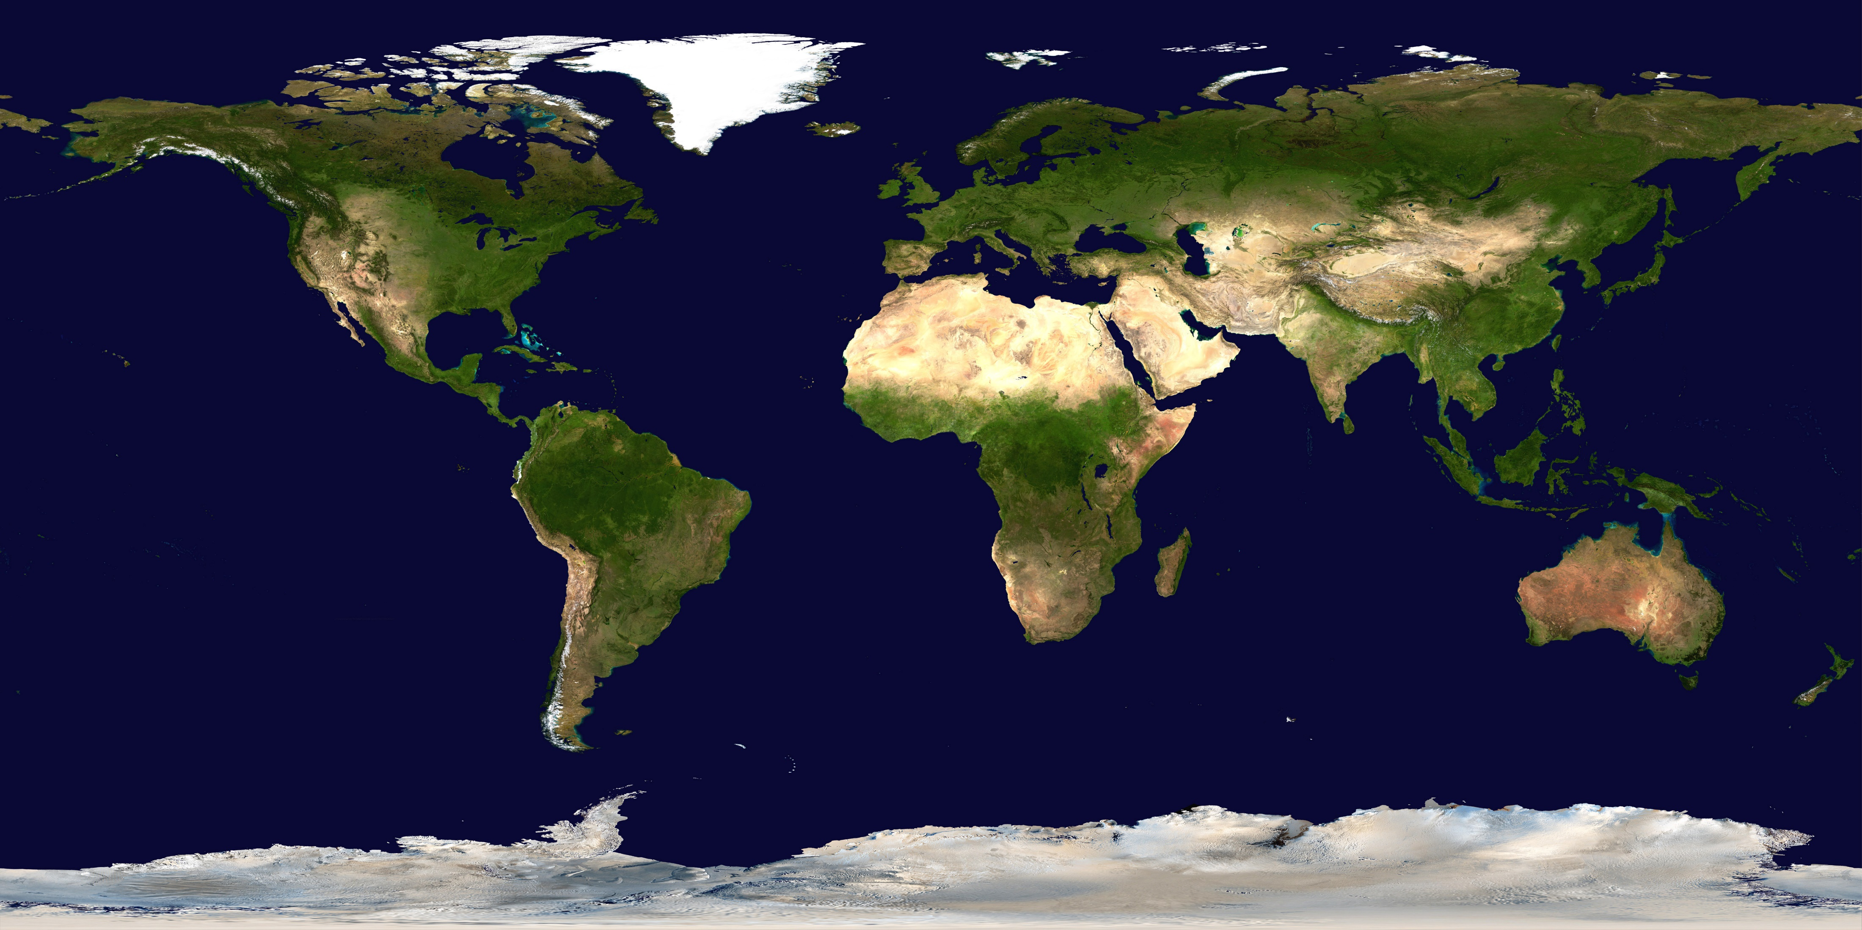
Our World is Becoming . .
More
Populated
Urbanized
Technological
Specialized
Connected
Globalized
Vulnerable
Impacting
Environment
Natural places
Biodiversity
Available resources
Security
Sustainability
…Increasingly affected by human activities

Slide 7
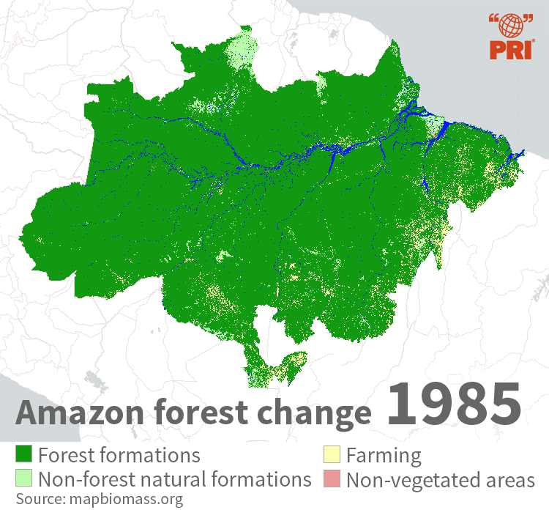
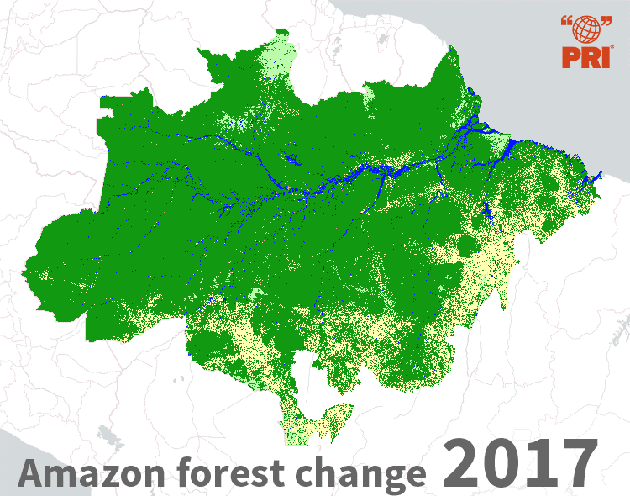
The evidence is everywhere
…We need to learn how to better manage our world
Notes:
https://pulitzercenter.org/reporting/amazon-used-be-hedge-against-climate-change-those-days-may-be-over#slideshow-7
http://apps.rcmrd.org/landcoverviewer/
We need to better monitor how the world is changing.

Slide 8
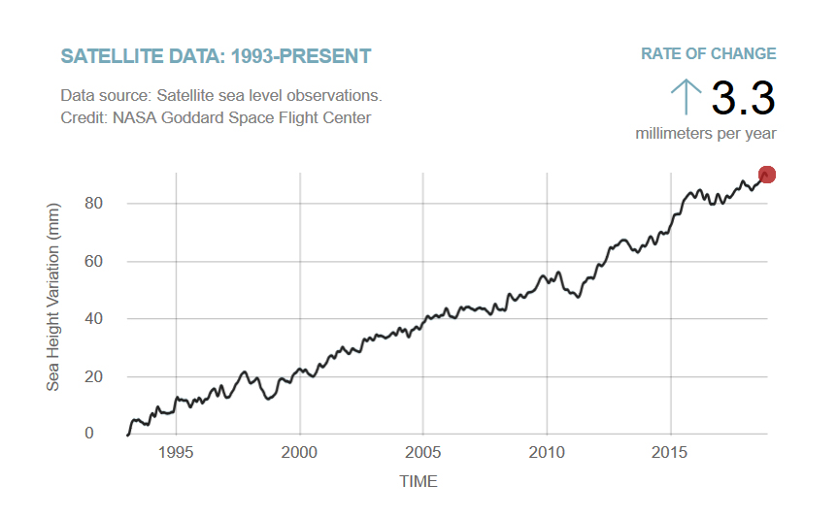
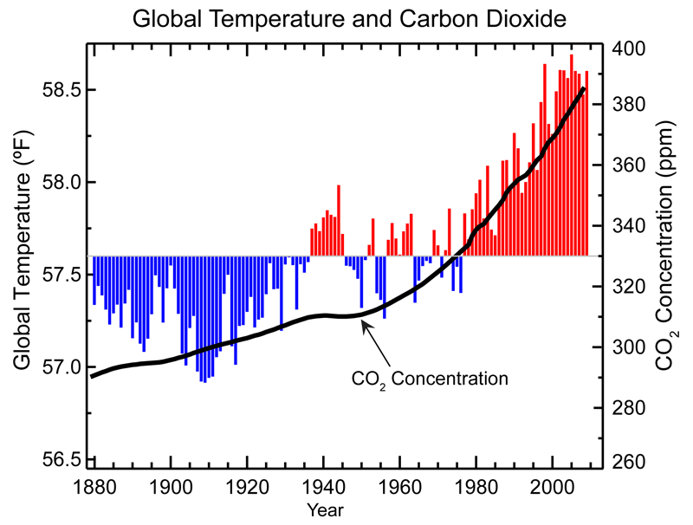
The evidence is everywhere
Source: NOAA (National Oceanographic and Atmospheric Administration)
…We need to learn how to better manage our world
Notes:
Source: NOAA (National Oceanographic and Atmospheric Administration), 2009, public domain Figure 3.2 Global records of average temperature and carbon dioxide (CO2) concentration show that as CO2 levels have increased over the past century, so have global temperatures.

Slide 9
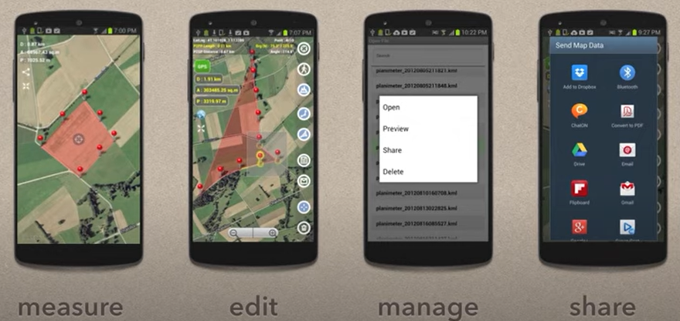
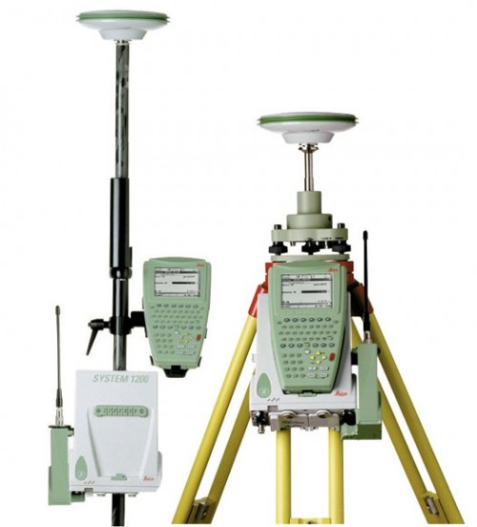
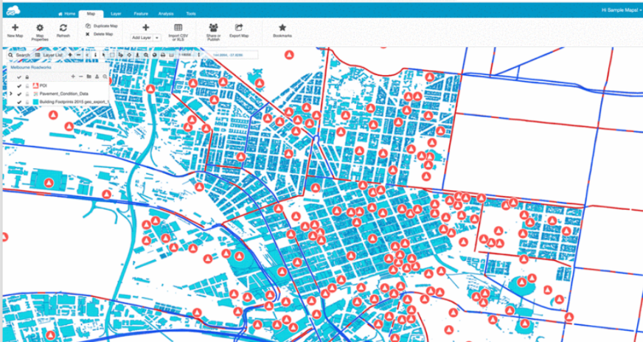

We are part of a Geodata society
Satellite imagery
GPS
Mobile mapping
Real time monitoring
Online GIS services
Web portals
. . .
…with more geospatial information

Slide 10
Some fundamental observations
Different processes dominate at different spatial scales
Some example of landscape scales:
Continent, ocean basin, climatic zone (~10,000,000 km²)
Mountain range (~1,000,000 km²)
Isolated sea (~100,000 km²) (Norway: 385,207 km²)
Massif, group of related landforms (~10,000 km²)
River valley (~1,000 km²)
Individual mountain, volcano, small valleys (~100 km²)
Hillslopes, stream channels, estuary, individual glacier (~10 km²)
Gully, small glaciers, rock glaciers (~1 km²)
Meter-sized features
… and temporal scales
Notes:
385,207 km²

Slide 11
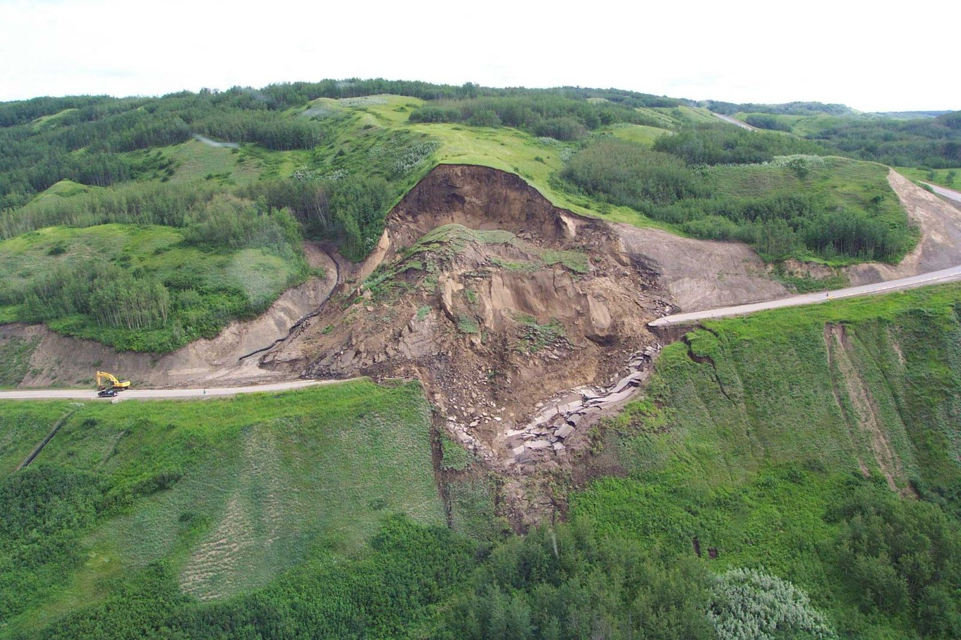
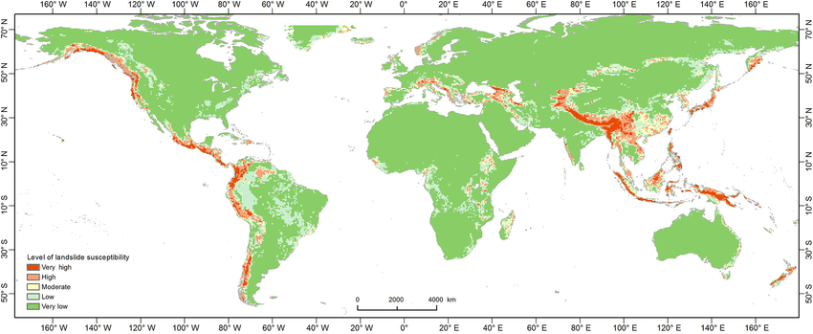
Some fundamental observations
Spatial and temporal-dimension
Landslide (local scale)
From local to global scale
(Lin et al., 2017.)
Notes:
(Lin et al., 2017. Landslide susceptibility mapping on a global scale using the method of logistic regression

Slide 12
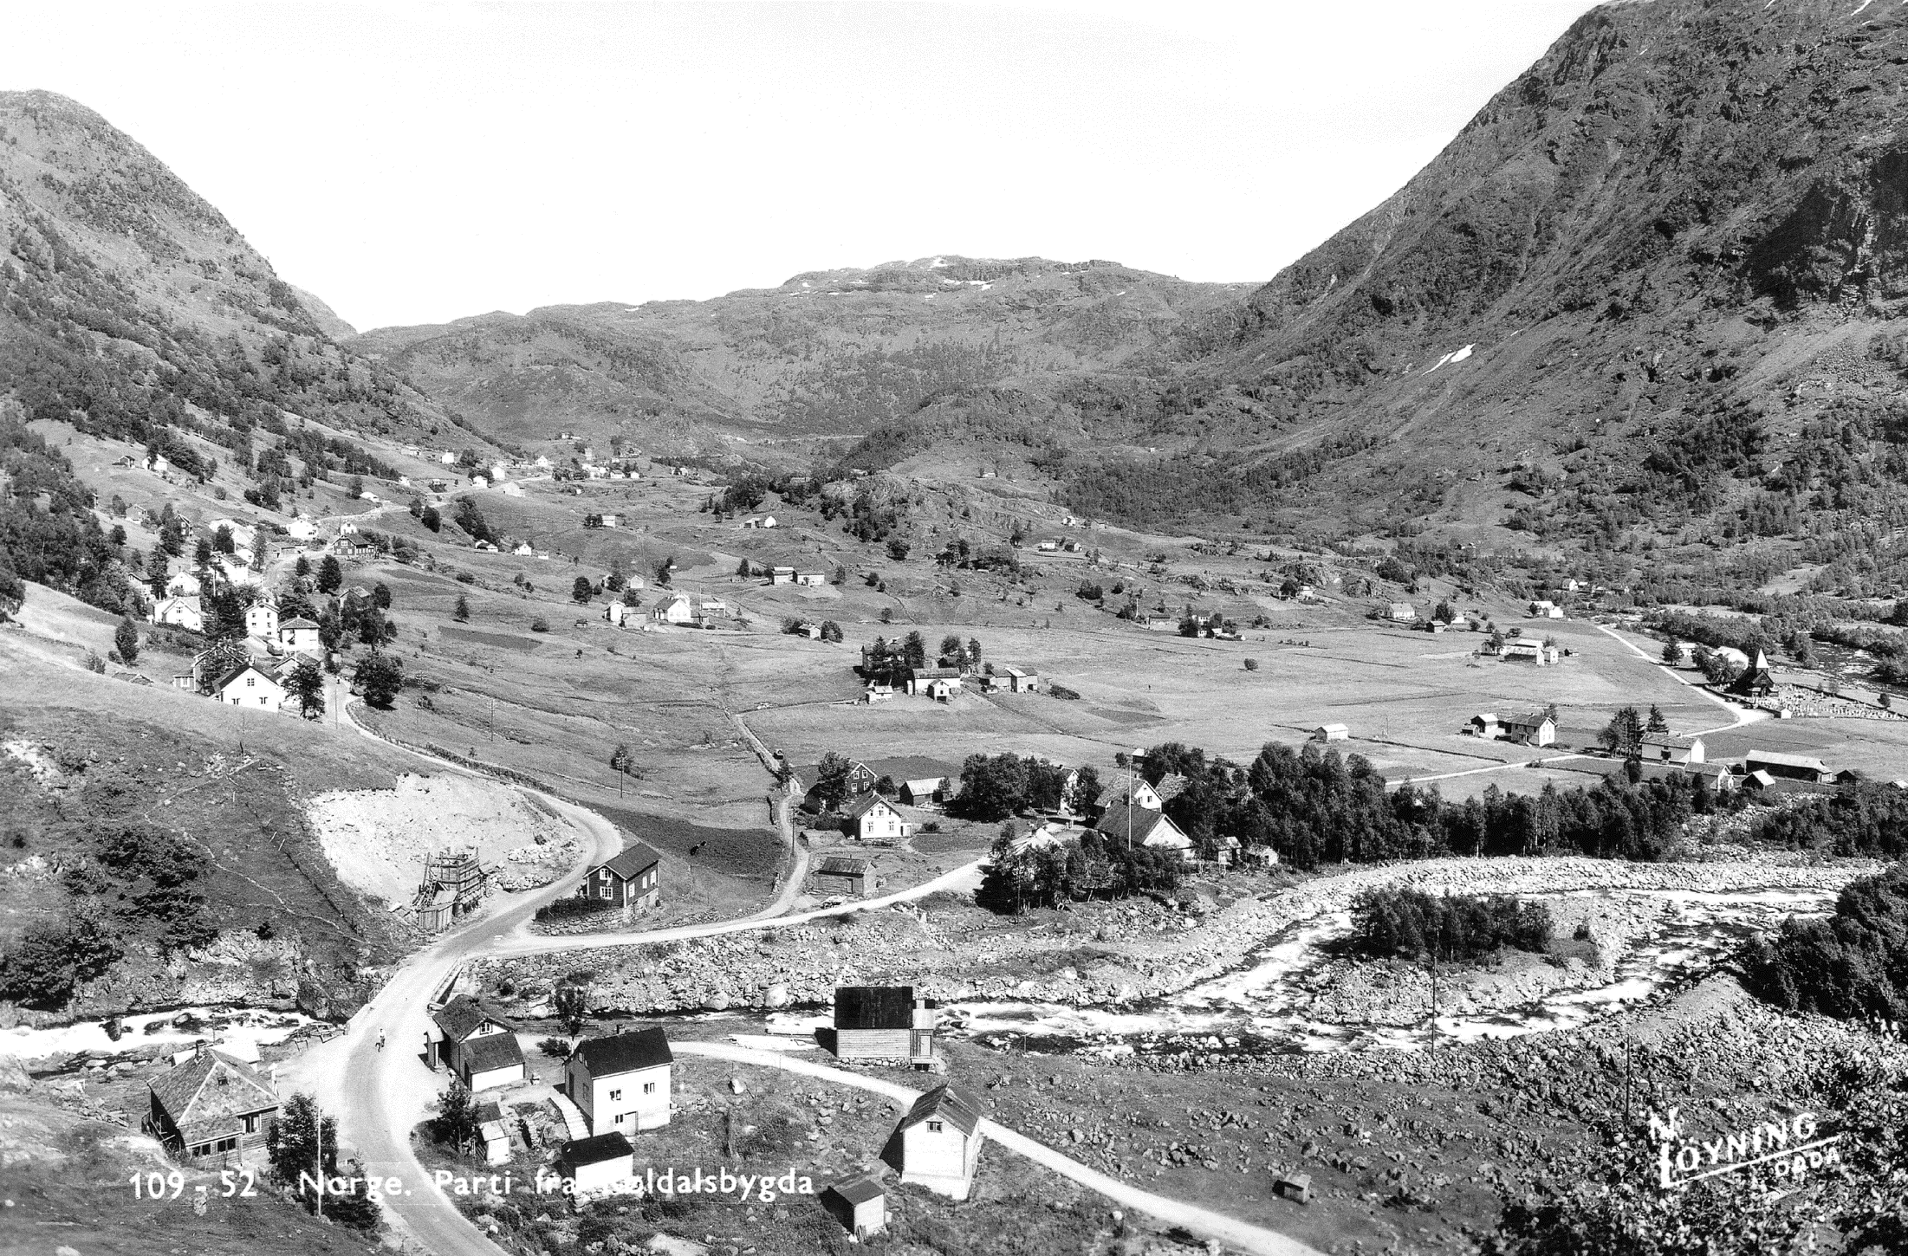
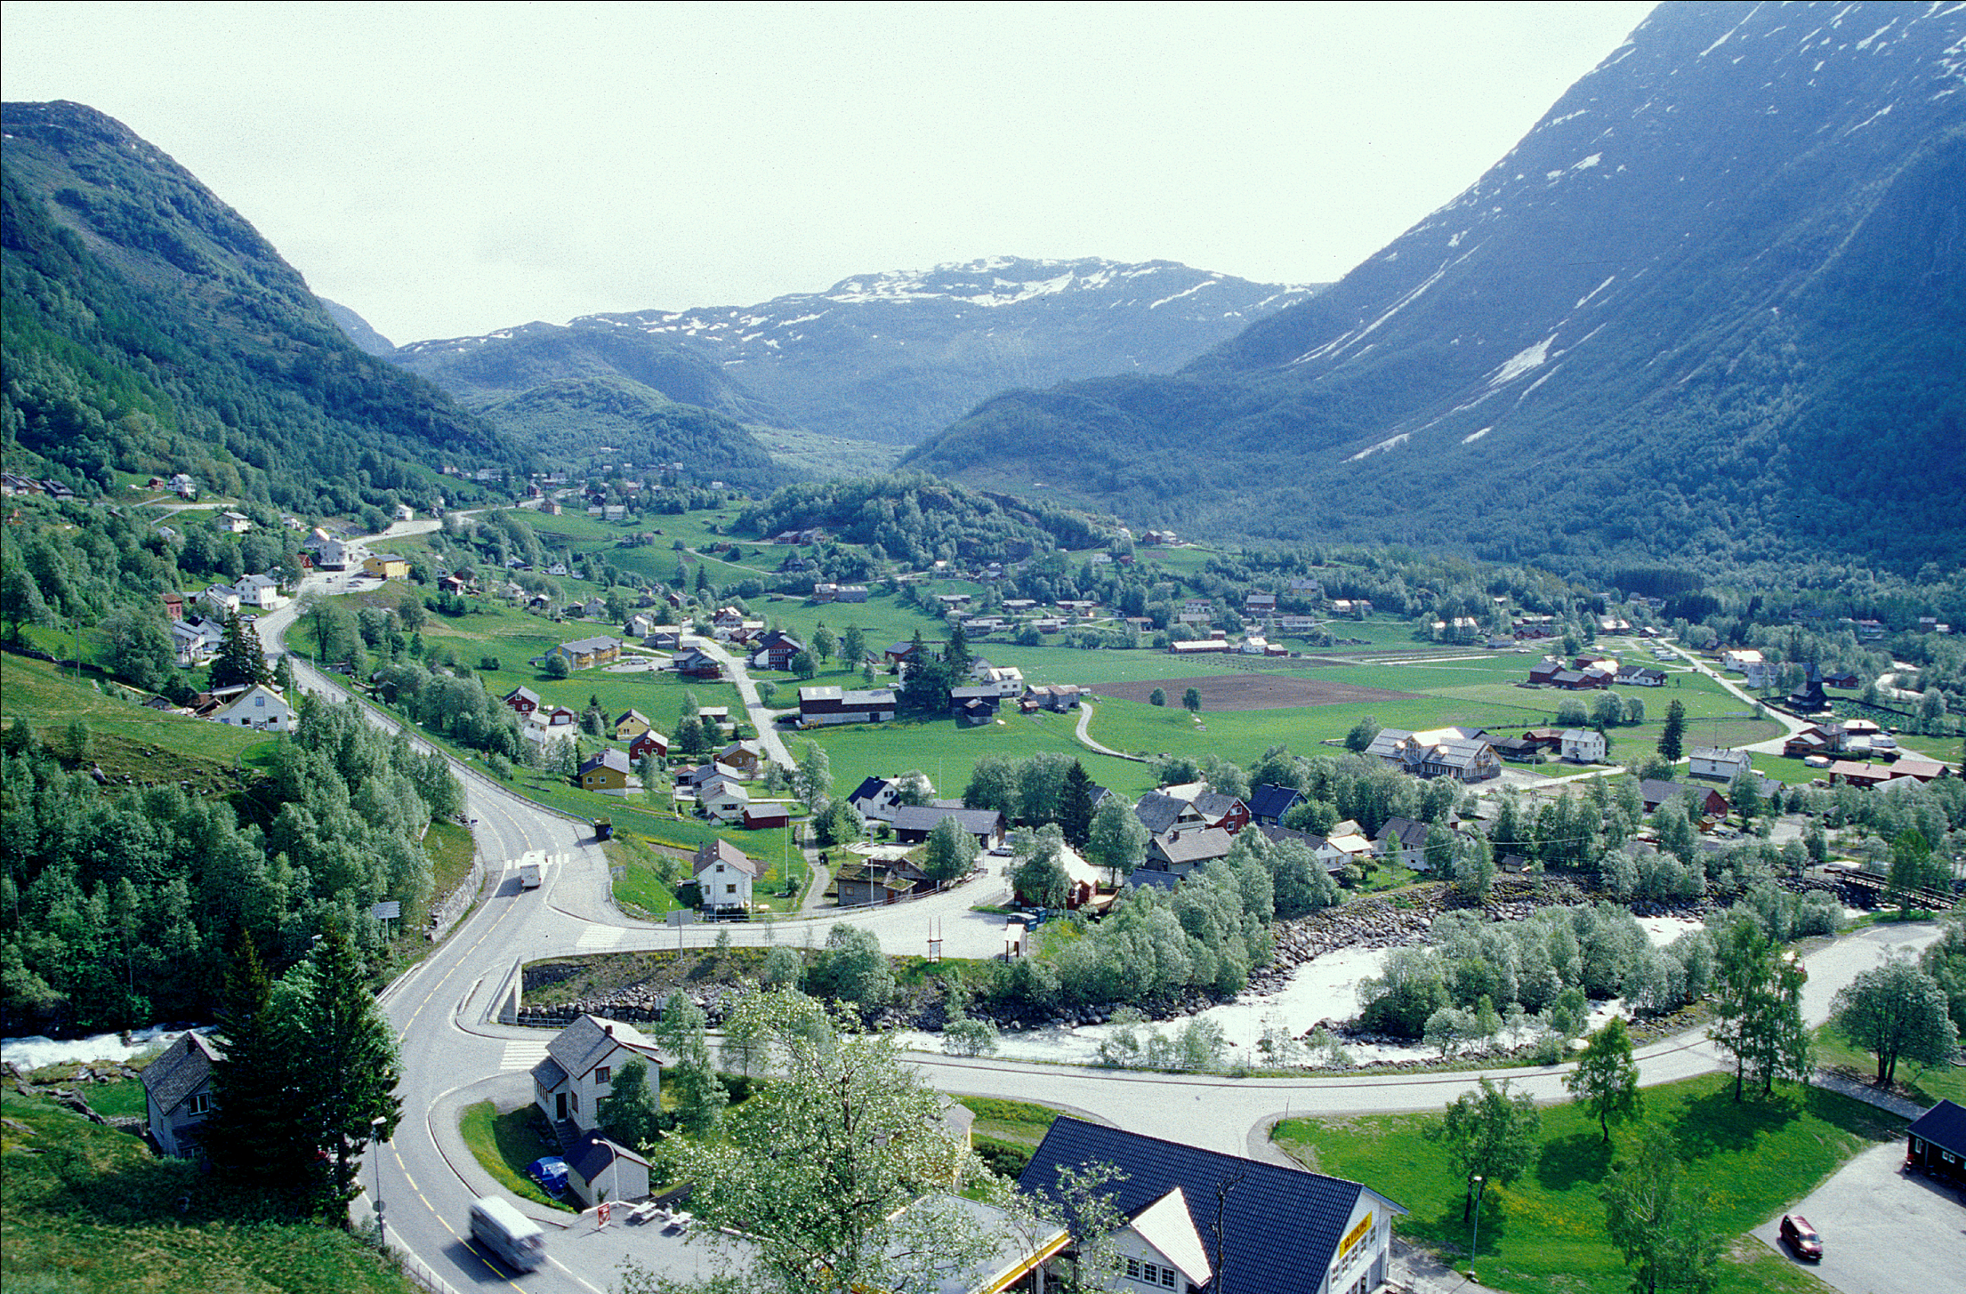
Some fundamental observations
Changes in ～50 years
Spatial and temporal-dimension
Source: N. Løyning. Røldalsbygda, Odda. 1952
Source: Oskar Puschmann, NIBIO. Røldal, Odda. 2003

Slide 13
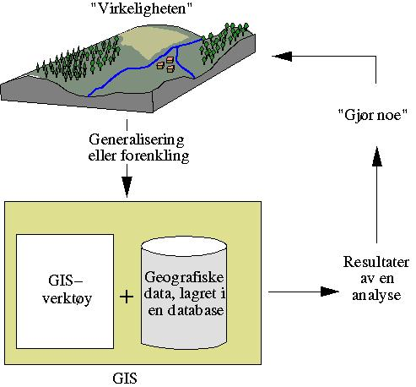
So What is GIS???
G: Geographic: Interest in SPATIAL IDENTITY or locality of certain entities
ON, UNDER or ABOVE the SURFACE of the EARTH.
I: Information: Data, processes, phenomena, facts are interpreted to CREATE INFORMATION that is useful for decision-making.
S: System: STAFF, COMPUTER HARDWARE and PROCEDURES, which can produce the information required for decision-making (data collection, processing, and presentation).
Notes:
The acronym GIS stands for geographic information system.
An analysis of the three letters of the acronym GIS gives a clear picture of what GIS is all about:
G: Geographic: Implies an interest in the spatial identity or locality of certain entities on, under or above the surface of the earth.
I: Information: Implies the need to be informed in order to make decisions. Data or raw facts are interpreted to create information that is useful for decision-making.
S: System: Implies the need for staff, computer hardware and procedures, which can produce the information required for decision-making that is data collection, processing, and presentation.
As the name suggests, a GIS is a tool for working with geographic information.
Data is georeferenced if it is associated with some position on the Earth’s surface by using a spatial reference system.
Data with positional data are called spatial data. As you know spatial data can have a local system so you have positional information without a geographic information or geographic data.

Slide 14


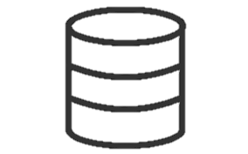


So What is GIS???
An integration of these five components
“A powerful set of tools for collecting, storing, retrieving at will, transforming, and displaying spatial data from the real world for a particular set of purposes”
- Burrough et al. 2015
People
Software
Data
GIS
Hardware
Analysis / procedures
Notes:
A Geographic Information System (GIS) is a system or collection of computer software, hardware and data, personnel that make it possible to enter, manipulate, analyze, and present data, and the information that is tied to a location on the earth's surface.
“A collection of computer hardware, software and procedures that are used to organize, manage, analyze and display geographically referenced datasets.…“
This system comprises of Software, Hardware, Data, and Personnel
that make it possible
to enter, manipulate, analyze and present information
Related to a location on the earth's surface.

Slide 15
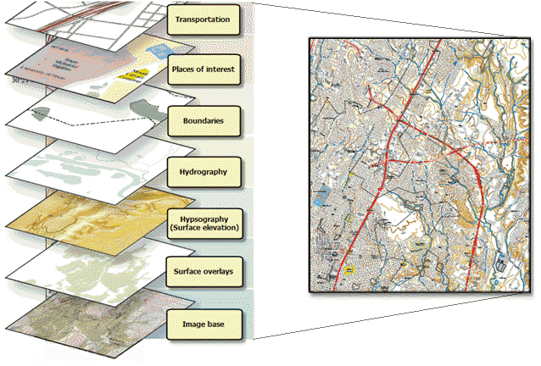
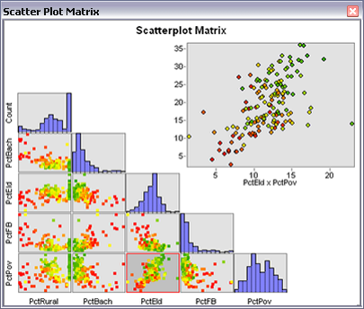
So What is GIS???
Answer questions by comparing different layer of data
1. Organize spatial data
3. Graphs, report
2. Display
A graphical explanation of the concept of layer
Notes:
All the information that we will use in a GIS will be in the form of layers. Each one of them can be used independently or along with others. The concept of layer is fundamental to understand GIS and helps to correctly structure and manage geographical information.
Layers also help avoid data redundancy, since each layer just contains information about a particular variable or type of feature
a GIS user expect from the system:
to enter and organized georeferenced data,
to analyse the spatial data in various ways, and
to produce presentations including maps from the data

Slide 16
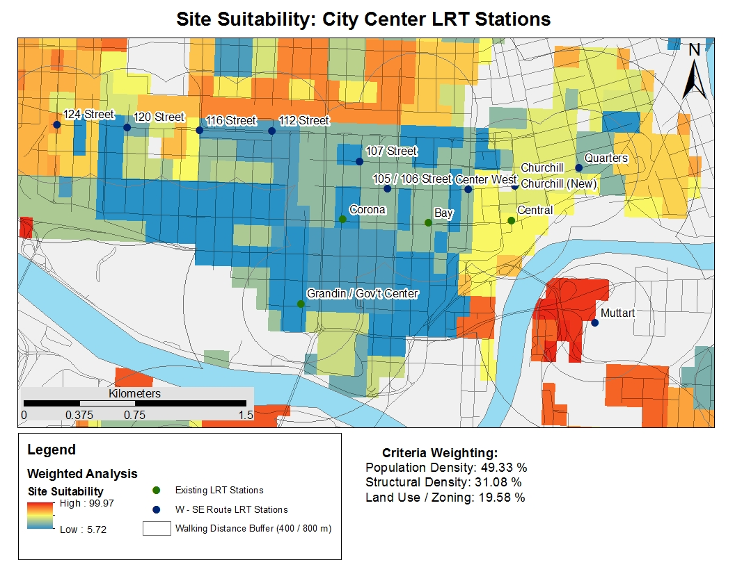
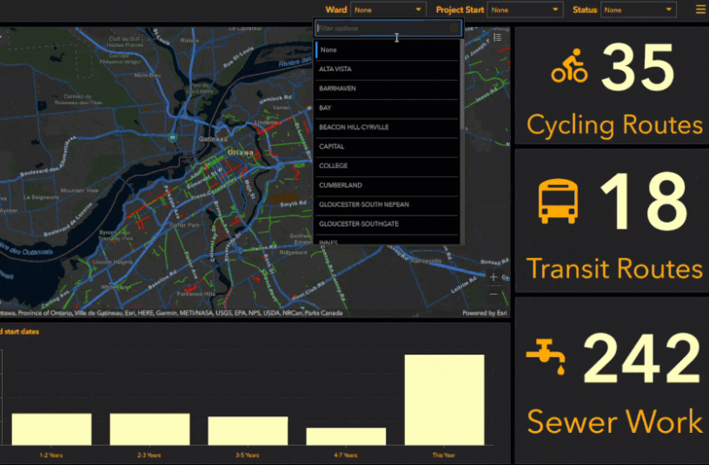
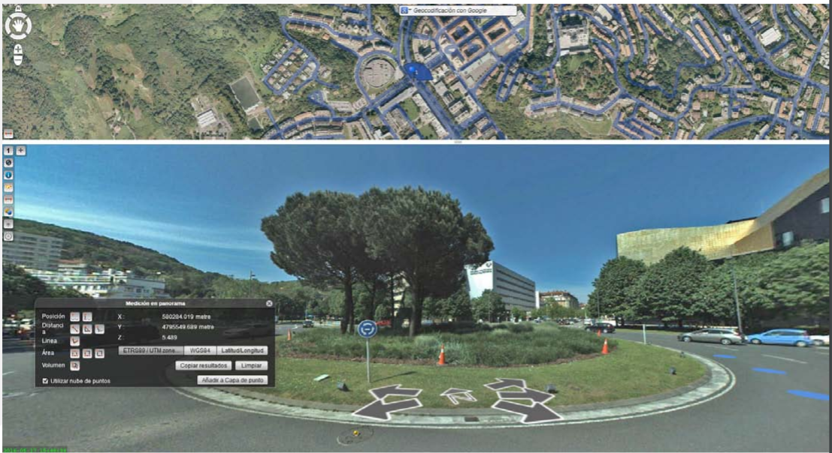
GIS use: Planning & economic development
Urban areas, smart city
Mobility
Conservation
Land use, land cover
Web-based suitability modelling
Site selection
Customer analysis
Real time data
. . .
Notes:
https://learn.arcgis.com/en/projects/predict-weather-with-real-time-data/

Slide 17
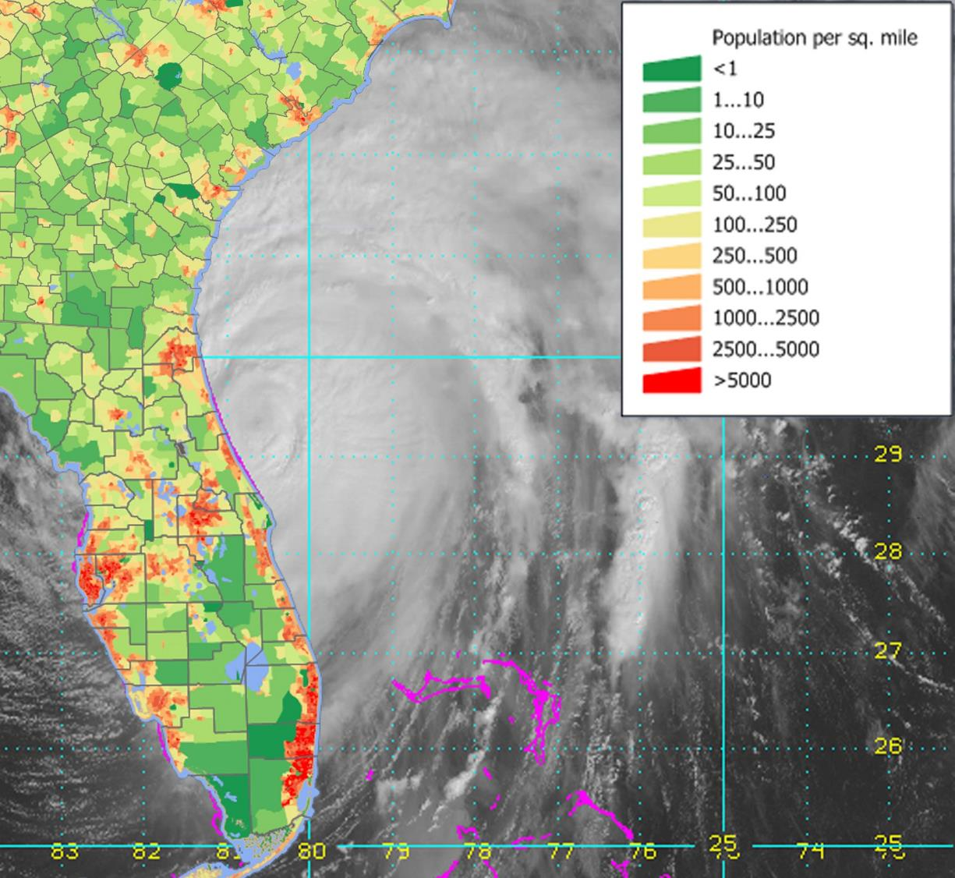
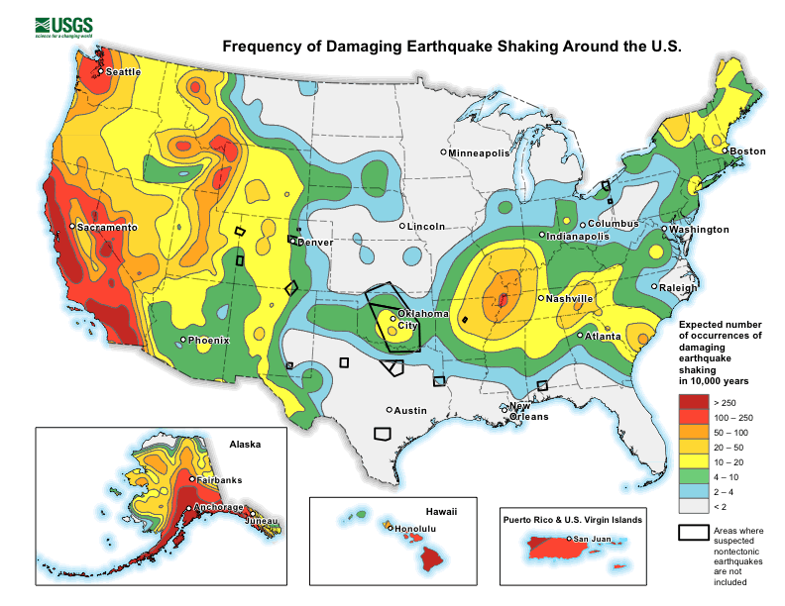
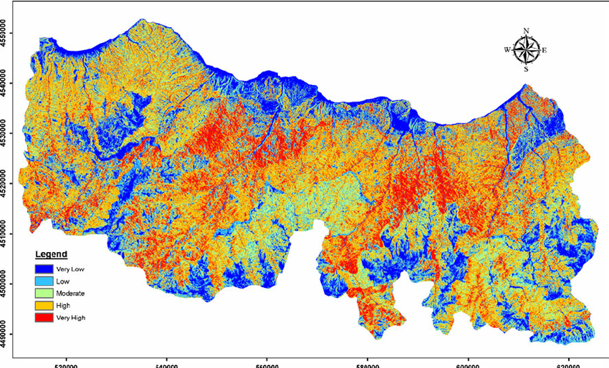
GIS use: Natural hazard
Monitoring
Damage assessment
Modelling
Real time tracking
Phenomena:
Hurricane
Earthquake
Landslides, slope stability assessment
Tsunami
Landslide susceptibility map
Notes:
Highly detailed weather data displayed in a data viewer can help groups, such as offshore operators, effectively manage a potential tropical weather impacts. Measuring the distance of a storm’s effect to an asset can help determine what actions need to be implemented, mitigating the overall risk. A good visualization of real-time weather data provides operators with another “view” of detailed guidance, other than more traditional static text reports.

Slide 18
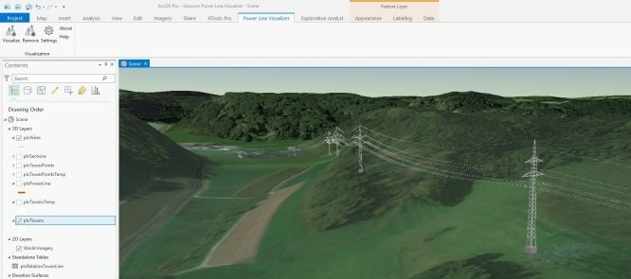
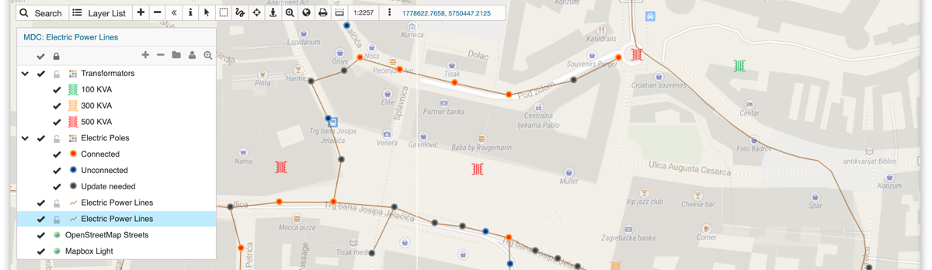
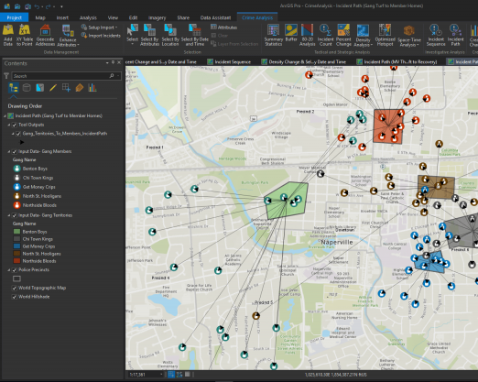
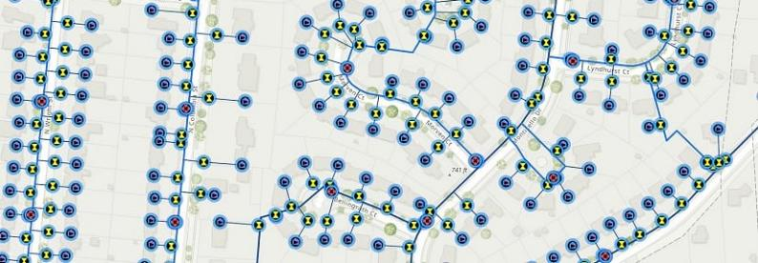
GIS use: Managing Utilities network, Infrastructure
Electricity network, power line
Water distribution
Agriculture
Property
Crime analysis
. . .

Slide 19
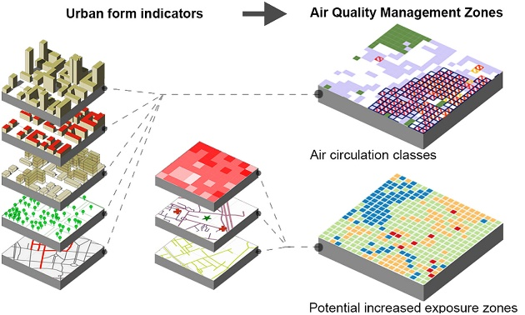
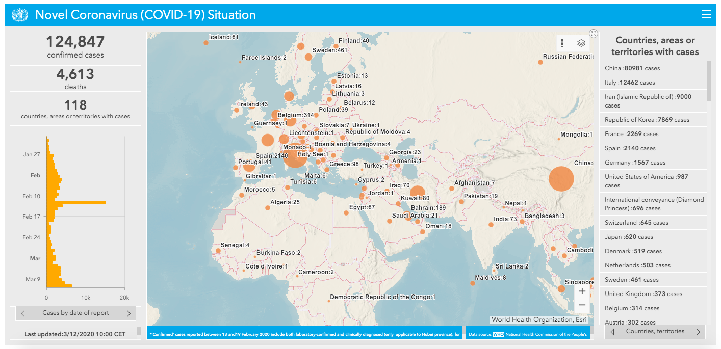
GIS use: Human health & Environment
Epidemiology
Air pollution monitoring
Contamination
. . .

Slide 20
Digital representation of spatial data
1
2
3
GIS
Spatial-temporal
What is a GIS
GIS applications
Digital representation
of spatial data
Geographic data
Continuous vs discrete data
Raster, Vector & Topology
Attributes
File
format
Notes:
The goal of the lecture is to provide a general overview of some of the term concept related to GIS and its use.
Basic of Geographic information systems (GIS)
Uses for GIS technologies
Raster and vector data
Now we will discuss the way these phenomena are presented and in general the specific characteristic of geospatial data.

Slide 21


Basic GIS questions
Real World
What is it?
What is its relation to other entities?
Where is it?
When is it?
Digital Environment

Slide 22
Basic GIS questions
Real World
Each geographical object has 3 basic components:
What?
Phenomena (with attribute)
Measured values
Quantitative (value with rank), ex. height
Qualitative (characteristic, class), ex. land use
Where?
Coordinates (2D, 3D), projection, coordinate system
When? (Time)
Snapshot (e.g. topographic map)
Time object (e.g. glacier front in different time periods)
Cyclic time ("repetitive" phenomena, e.g. season)
Digital Environment
Notes:
Each geographical object has 3 basic components:
What?
Phenomena with Attribute. An object can have several attributes
Measured values
Quantitative (value with rank), ex. Height
Qualitative (characteristic, class), ex. land use
Where?
Coordinates (2D or 3D), projection and coordinate system
When? (Time)
Snapshot (eg topographic map)
Time object (eg glacier front in different time periods)
Cyclic time ("repetitive" phenomena, eg season, bus route)

Slide 23
Basic characteristics of geographic data
Real World
How do we represent the real world and geographical phenomena?
Digital Environment
Data in a GIS represent a simplified view of physical entities or phenomena

Slide 24
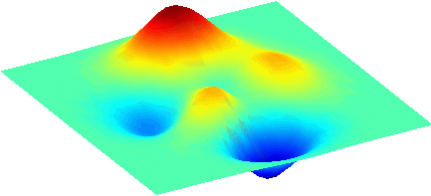
Basic characteristics of geographic data
Phenomena =
elevation
Geographic phenomena in the real world exist as:
Objects/entities (discrete):
Points, Lines, Polygons
Continuous fields
Point =
mountain peak
Line =
road
Polygon =
lake
66.4N, 15.2E

Slide 25
Basic characteristics of geographic data
Phenomena =
elevation
Geographic phenomena in the real world exist as:
Objects/entities (discrete):
Points, Lines, Polygons
Continuous fields
Spatial data have two distinct components
Place (geographical location)
Attribute (properties)
Point =
mountain peak
Line =
road
Polygon =
lake
66.4N, 15.2E

Slide 26
Basic characteristics of geographic data
Real World
Spatial location
Continuity (continuous vs discrete)
Attributes (level of measurement)
Digital Environment

Slide 27
Basic characteristics of geographic data
Real World
Spatial location
Continuity (continuous vs discrete)
Attributes (level of measurement)
Digital Environment

Slide 28
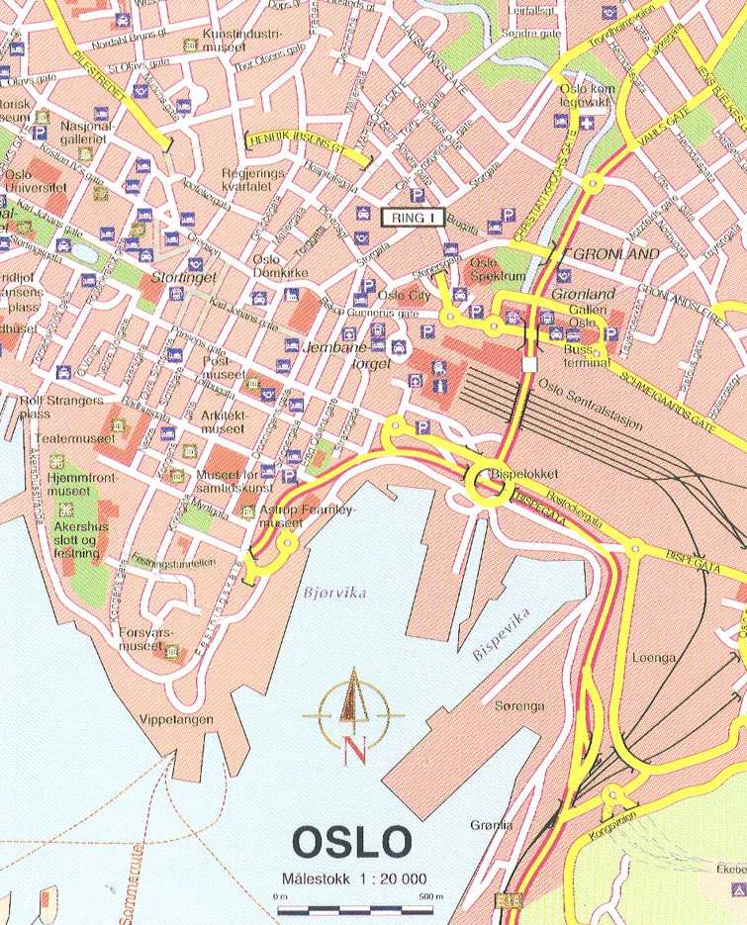
Geographical location
Absolute reference system
Georeferencing systems
Ellipsoids
Geoids
Datum
Projections
Coordinate systems
Relative reference system
Local coordinate systems
Geographical information
E.g. postcodes, administrative units
Notes:
Data is georeferenced if it is associated with some position on the Earth’s surface by using a spatial reference system.
Data with positional data are called spatial data.
As you know spatial data can have a local system so you have positional information without a geographic information or geographic data.

Slide 29
Basic characteristics of geographic data
Real World
Spatial location
Continuity (continuous vs discrete)
Attributes (level of measurement)
Digital Environment

Slide 30
Continuous vs. discrete data
Discrete object
The space is empty except where there are objects
The object has well-defined delimitation.
Objects can be counted. Examples:
Points: Town, power pole
Line: river stream, highway
Polygon (area): national park, countries
Continuous object
Data values distributed across a surface without interruption
Each variable is defined at every possible position
Example: Temperature, elevation
Notes:
Continuous vs. discrete
Continuous Data values distributed across a surface without interruption –Key words: What varies and how smooth?
Examples: elevation, temperature
Discrete –with well-defined boundaries in otherwise empty space
Examples Points: Town, power pole Lines:
Highway, stream Areas: U.S. Counties, national parks
https://desktop.arcgis.com/en/arcmap/latest/extensions/3d-analyst/discrete-and-continuous-data-in-3d-analyst.htm

Slide 31
Continuous vs. discrete data
Some data types may be presented as either discrete or continuous
Example:
Population at a point (discrete)
Population density surface for an area (continuous)

Slide 32
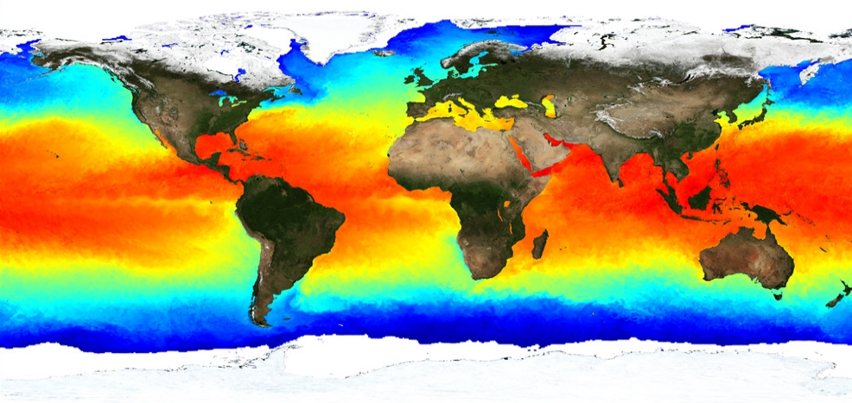
Continuous vs. discrete data?
Sea Surface Temperature (SST) (°C)
Notes:
The map above shows the temperature of the ocean surface (called “sea surface temperature” or SST).
The data to make this map was collected by instruments on the GOES and POES satellites from June 21-24, 2005.
Red and yellow colors indicate warmer water than blue and green colors.
Let them discuss this and the next slide

Slide 33
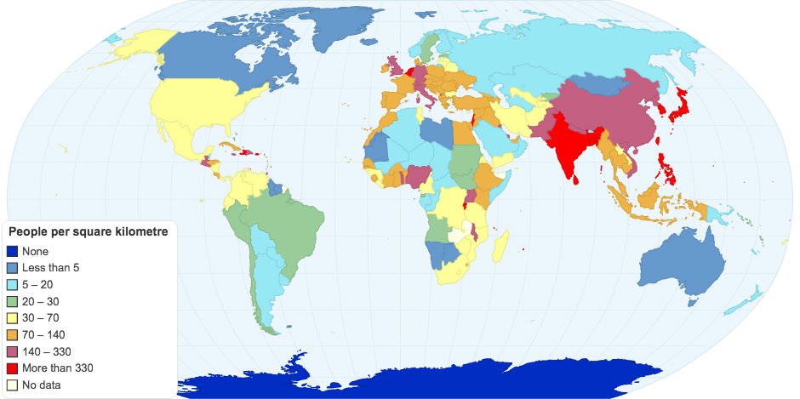
Continuous vs. discrete data?
Sea Surface Temperature (SST)

Slide 34
Digital representation of spatial data
How would you represent geographical object?
Notes:
How would you represent geographical object?
We have two common data models to represent reality in a GIS.

Slide 35
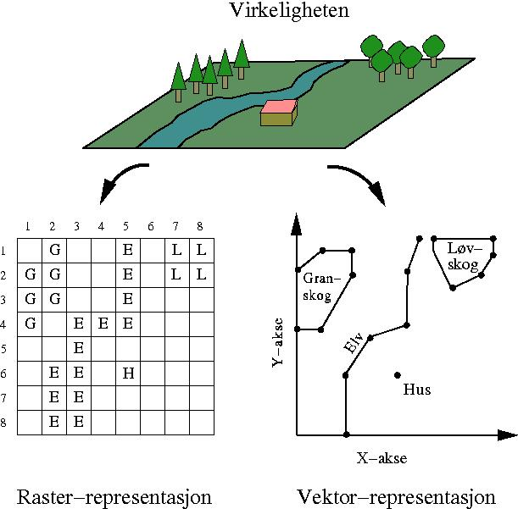
Digital representation of spatial data
Raster and vector data are used for representing continuous and discrete objects
Raster representations: divide the world into arrays of cells and assign attributes to the cells.
Vector data uses sets of coordinates and associated attribute data to define discrete objects. There are three basic types of vector objects: points, lines, and polygons.
Notes:
This is an illustration of transferring a real world geographic area into the raster and vector formats.
In the raster format the geographic area is parcelled into numerous grid squares and the value that makes up the majority of the square dictates that that entire square gets the value.
In the vector format all entities are classified into points, lines, or polygons. Source: Defence Mapping School National Imagery and Mapping Agency's digitally?

Slide 36
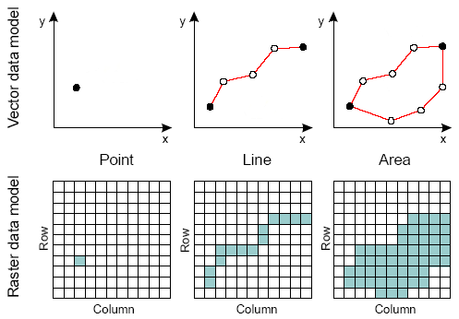
Digital representation of spatial data
Raster and vector data are used for representing continuous and discrete objects
Raster representations: divide the world into arrays of cells and assign attributes to the cells.
Vector data uses sets of coordinates and associated attribute data to define discrete objects. There are three basic types of vector objects: points, lines, and polygons.

Slide 37
Digital representation of spatial data
Raster data
Define space as an array of equally sized cells arranged in rows and columns. Each cell contains an attribute value and location coordinates.
Notes:
https://www.youtube.com/watch?app=desktop&v=-7R2NEB8mnc

Slide 38
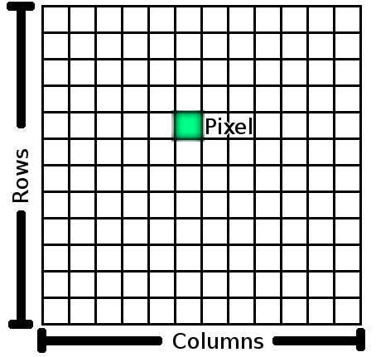
Digital representation of spatial data
Raster data
Define space as an array of equally sized cells arranged in rows and columns. Each cell contains an attribute value and location coordinates
Pixel
Matrix of pixels or cells
Rows
Columns
size
Notes:
The spatial unit of a raster is pixels or also called..

Slide 39
Digital representation of spatial data
Raster data
Define space as an array of equally sized cells arranged in rows and columns. Each cell contains an attribute value and location coordinates
Pixel
Data type
Integer for discrete or bolean (0,1 data)
Float for continuous data
Nodata (nan, NoData, -9999, 99999)
Discrete or continuous
size
5
0
5.3

Slide 40
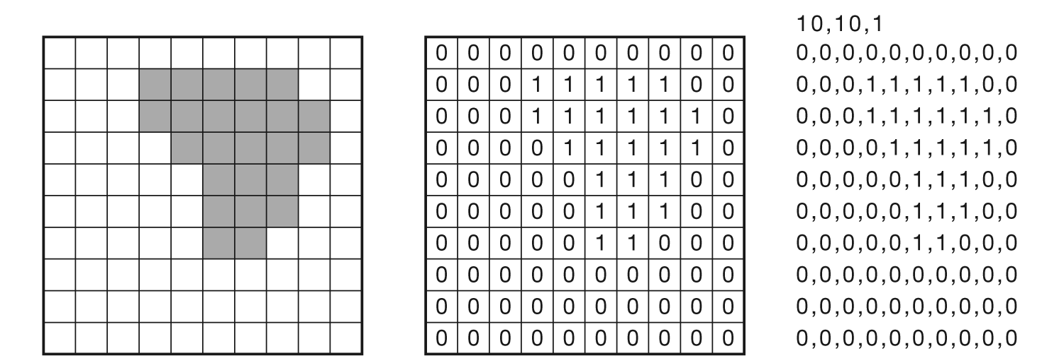
Digital representation of spatial data
Raster data: Data type
entity model
cell values (bolean)
File structure
Notes:
Due to this, raster layers can be seen as matrices, and the corresponding mathematical tools can be used for their analysis.
Cells in a raster grid with their associated values.
https://volaya.github.io/gis-book/en/Data.html

Slide 41
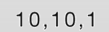
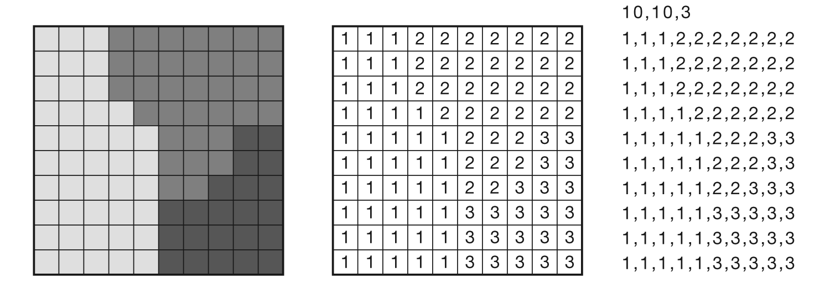
Digital representation of spatial data
Raster data: Data type
entity model
cell values (integer)
File structure

Slide 42
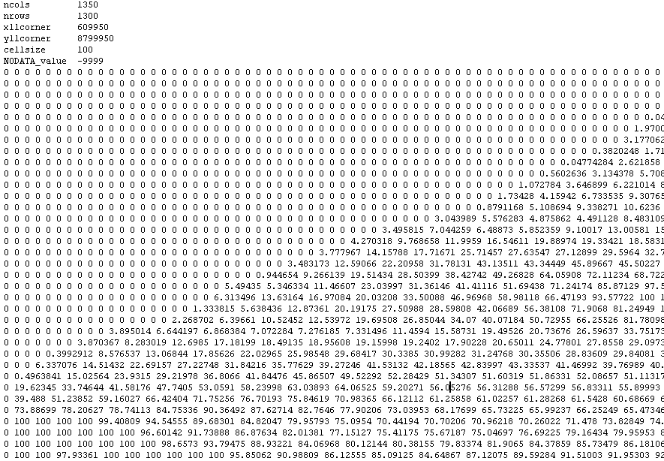
Digital representation of spatial data
Raster data: Data type
.txt file of a
Digital Elevation Model (DEM)
Header
cell values float
Grid with elevation (m)

Slide 43
Digital representation of spatial data
Raster data: Data type
Discrete raster:
Relative few possible values with boundaries.
Example: Land use and land cover map (raster), soil types, etc.
Continuous raster:
Numeric values range smoothly from one location to another.
Example: Digital elevation model (DEM), temperature, remote sensing images

Slide 44
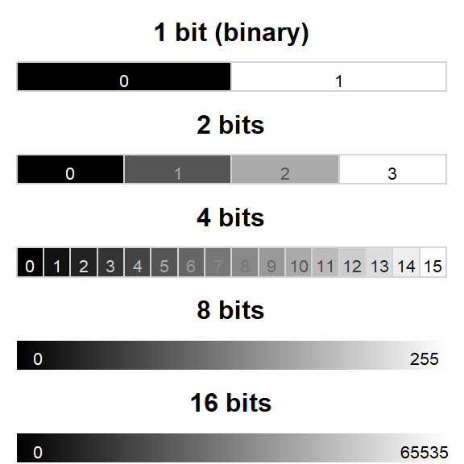
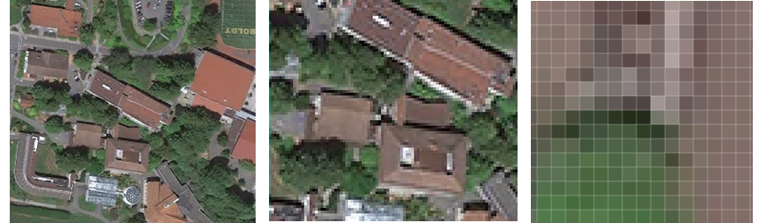
Digital representation of spatial data
Raster data: Data type
Bit depth: number of possible values / colours for each cell
1 byte / cell = 8 bits / cell = 2 ^ 8 = 256 shades of gray (from 0 to 255)
Ex. RGB image, elevation raster
2 bytes / cell = 16 bits / cell = 2 ^ 16 = 65536 grayscale (from 0 to 65535).
Ex. satellite image (multispectral)
Notes:
Raster are in part defined by their pixel depth. Pixel depth defines the range of distinct values the raster can store.
For example, a 1-bit raster can only store 2 distinct values: 0 and 1.
There is a wide range of raster file formats used in the GIS world. Some of the most popular ones are listed below.

Slide 45
Digital representation of spatial data
Raster data:
Define space as an array of equally sized cells arranged in rows and columns. Each cell contains an attribute value and location coordinates
Pixel
Spatial resolution (pixel/cell size)
The level of detail in a raster or image
The pixel size on the ground (not the pixel on your screen)
Number of pixels in a given frame
size

Slide 46
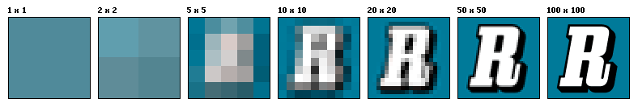
Digital representation of spatial data
Raster data: Spatial resolution,
Ground Sampling Distance (GSD)
→ (pixel/cell size)
Pixel
size
1m 0,5m 0,2m 0,1m 5cm 2cm 1cm
Grov oppløsning
Fin oppløsning
Spatial resolution should be less than half the size of the smallest object you want to map
Notes:
Resolution is an important concern in raster representations.

Slide 47
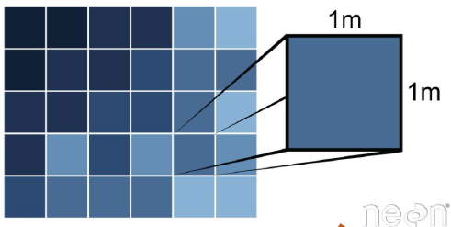
Digital representation of spatial data
Raster data: Spatial resolution (pixel/cell size)
Remember: raster resolution is a tradeoff between the information you want to convey and the size (and processing time) of the file you are dealing with.
“1 m resolution”
“0.5 m resolution”
1 m
1 m
1 m
1 m
Note: To DOUBLE the resolution, we have to QUADRUPLE the cells. So be very careful, because files can get really big.
Notes:
Resolution is an important concern in raster representations.

Slide 48
Digital representation of spatial data
Raster data: Spatial resolution (pixel/cell size)
Example: Orthophoto
Note: for rasters, the resolution is constant across the dataset
Spatial resolution should be less than half the size of the smallest object you want to map
Cell resolution is given as its size on the ground.
Notes:
Spatial (or geometric) resolution. Pixel size or density.
For a small grid, the resolution is coarse but the required storage space is limited. For a large grid the resolution is fine, but at the expense of a much larger storage space. On the above figure, the real world (shown as an aerial photograph) is simplified as a grid where the color of each cell relates to an entity such as road, highway or river.

Slide 49
Digital representation of spatial data
Rasters as basemaps
Orthophotos displayed underneath other layers
Example: orthophotos from aerial photography, satellite imagery, and scanned maps
Rasters as surface maps:
Representing data that changes continuously across a landscape (surface)
Method of storing the continuity as a surface
Example: Elevation values, temperature, rainfall, concentration
Rasters as thematic maps:
Representing thematic data
Example: classified satellite image by land-cover categories
Important: map layers must be spatially aligned
Notes:
Orthophotographs displayed underneath other layers provide the map user with confidence that map layers are spatially aligned and represent real objects, as well as additional information. Three main sources of raster basemaps are orthophotos from aerial photography, satellite imagery, and scanned maps

Slide 50
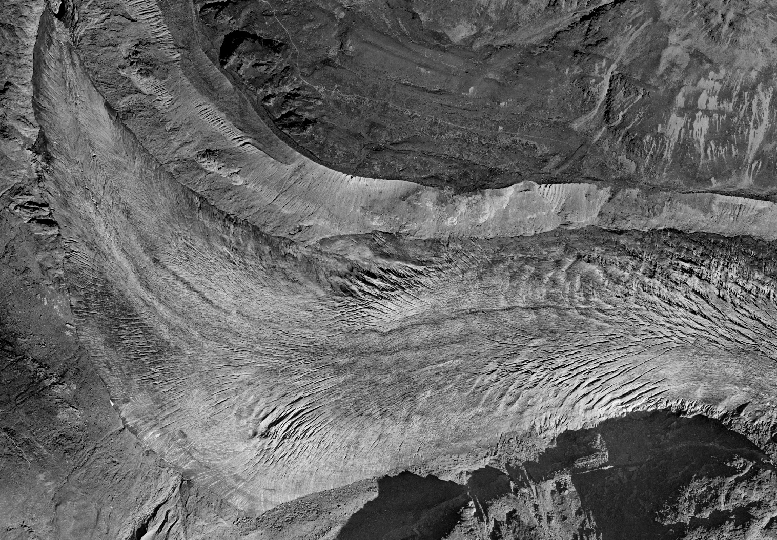
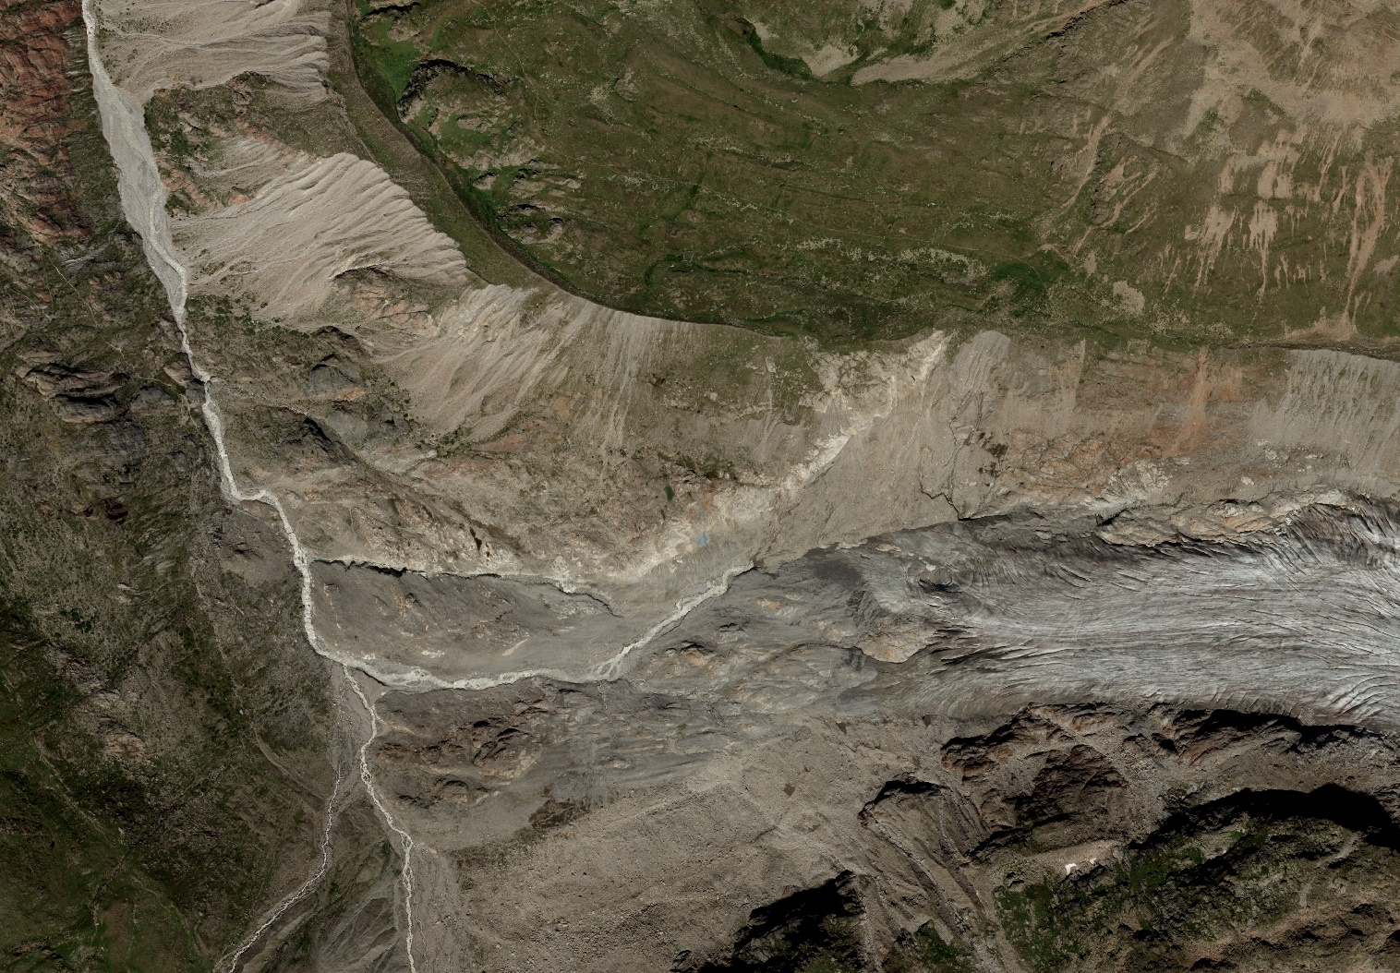
Digital representation of spatial data
Rasters as basemaps
Example: Orthophoto as a base to map features
1953
2015
Alpine catchment in Austria (Gepatch, Austria). Glacier.

Slide 51
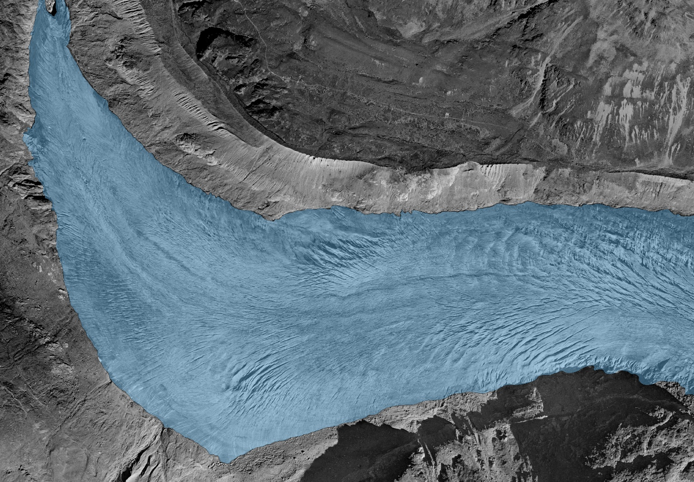
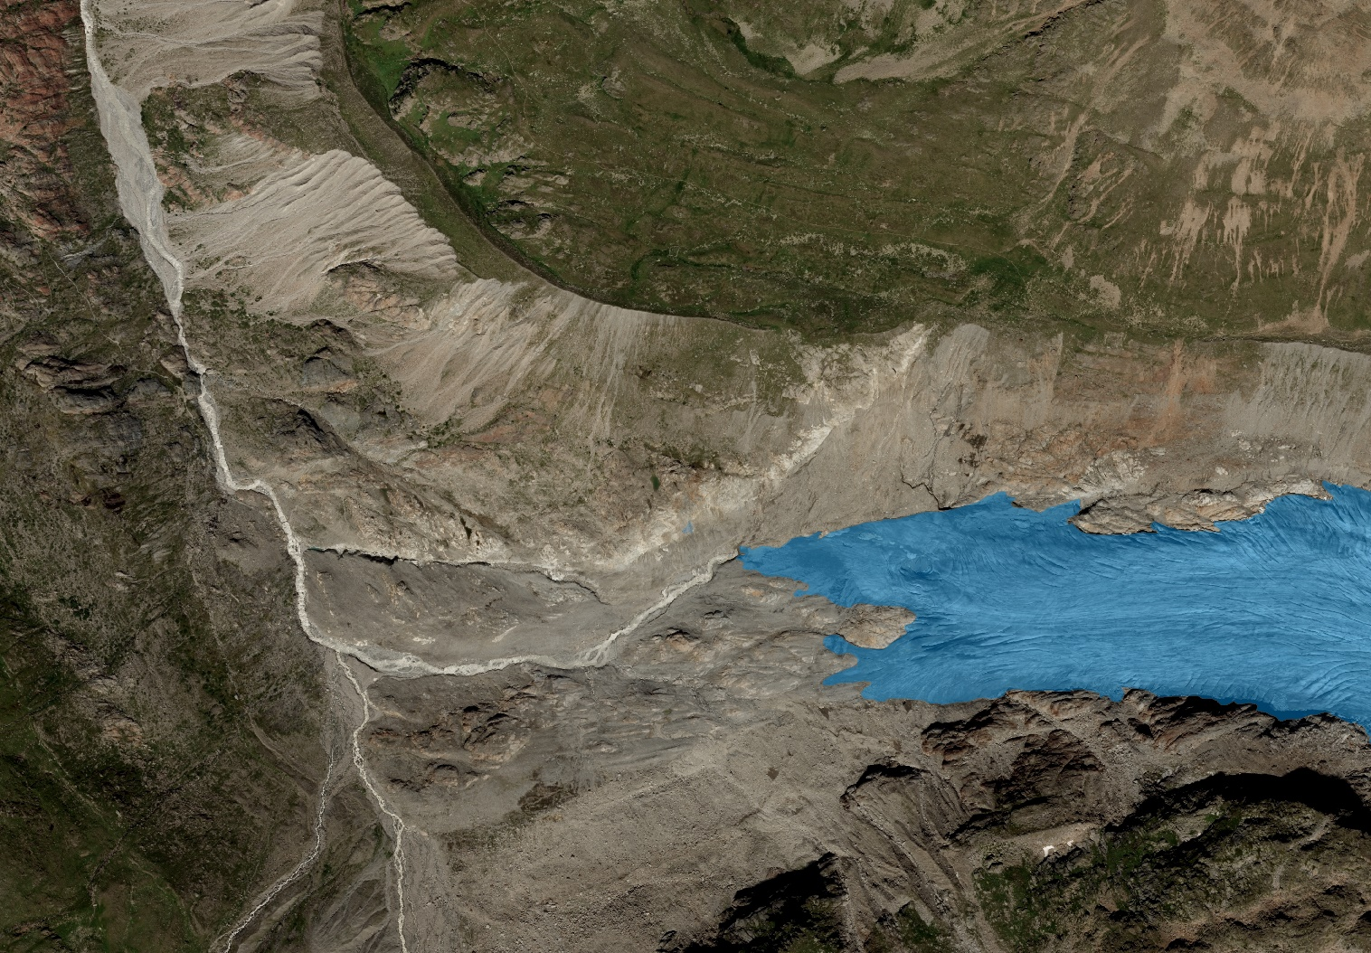
Digital representation of spatial data
Rasters as basemaps
Example: Orthophoto as a base to map features
1953
2015
Mapping glacier extension change from orthophoto
Alpine catchment in Austria (Gepatch, Austria). Glacier.
Notes:
https://www.youtube.com/watch?app=desktop&v=-7R2NEB8mnc

Slide 52
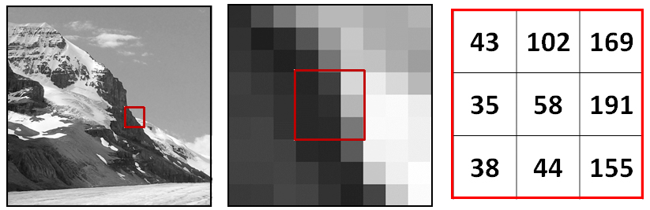

Digital representation of spatial data
Rasters as basemaps
Remember: maps and orthophoto are numbers first, images later

Slide 53


Digital representation of spatial data
Rasters as surface maps
Example: Digital elevation model (DEM)
Elevation values measured from the Earth's surface are the most common application of surface maps
Other values can also define surfaces and be spatially analyzed
Rainfall
Temperature
Concentration
population density
2015
Alpine catchment in Austria (Gepatch, Austria). Glacier
Notes:
Rasters are well suited for representing data that changes continuously across a landscape (surface).
They provide an effective method of storing the continuity as a surface.
They also provide a regularly spaced representation of surfaces.
Elevation values measured from the earth's surface are the most common application of surface maps, but other values, such as rainfall, temperature, concentration, and population density, can also define surfaces that can be spatially analyzed.
The raster displays elevation—using green to show lower elevation and red, pink, and white cells to show higher elevations.

Slide 54

Digital representation of spatial data
Rasters as thematic maps
Example: Land use map (raster)
How do you see that this is a raster!?
Notes:
Here is an example of a classified raster dataset showing land use.

Slide 55

Digital representation of spatial data
Raster data: Visualization
Colour table:
continuous
In a GIS, the raster values are often assigned to grayscale / colour automatically when loading (8 bit, 0-255 values)
The user can adjust the colour balance using:
stretching (continuous representation)
histogram adjustment
classification (discrete representation)
discrete

Slide 56




Digital representation of spatial data
Raster data: Accuracy and Precision
“Accuracy is telling the truth . . . Precision is telling the same story over and over again.” Yiding Wang
Accuracy: how close is a value to the “Truth”?
Coordinate accuracy - right place
Attribute accuracy - correct attribute value
Precision: how close is a value to the other values?
Figure 1: Precision
Figure 2: Accuracy
Figure 3: Accuracy with Precision
Figure 4: Accuracy with Precision and blunder
Notes:
We will talk about the quality and the error in another lecture.
However the concept is that with GIS we can combine and analyse georeferenced data from a range of sources, therefore we must pay attention to the issues of data quality an error as data from different sources are also likely to contain different kind of error.
This might include mistakes or variation in measurements of position and or elevation, in the quantitative measurement of attributes or in the labelling or classification of features.
It is important however to distinguish between gross errors (blunders or mistakes) which must be detected and removed before the data is used variation in the data caused by not avoidable measurement and classification errors.
Accuracy is measuring near the true value. Precision is getting consistent results.

Slide 57
Digital representation of spatial data
Raster data
Advantages
Simple data structure
Easy overlay
Various kinds of spatial analysis
Uniform size and shape
Disadvantages
Large amount of data
Less “pretty”
Projection transformation is difficult
Different scales between layers can be a nightmare
May lose information due to generalization
Notes:
+ Simple and robust data structure
+ Well-designed computer architecture, able to read and process such data very easily
+ Nice to represent continuous data (surfaces)
+ Cheap technology (in all image programs), natural for aerial images, satellite images etc.
- Large amounts of data, redundancy problem
(coding / search trees to limit storage needs)
- Less suitable for representing points, lines and polygons, as well as structural elements (eg cliffs)
- Limited possibilities for topological analyzes

Slide 58
Digital representation of spatial data
Vector data model
Uses sets of coordinates and associated attribute data to define discrete objects.
There are three basic types of vector objects: points, lines, and polygons.

Slide 59

Digital representation of spatial data
Vector data model
Landscape features as we would represent them in a GIS
Line
River
Road
Point
Trees
Polygons
Houses

Slide 60
Digital representation of spatial data
Vector data are defined spatially as either:
Point: a pair of x and y coordinates
Line (polyline): a sequence of points
Polygon: a closed set of lines
(x₁, y₁)
vertex
node
Notes:
Vector representation is composed of three main elements: points, lines and polygons.
Points are spatial objects with no area but can have attached attributes since they are a single set of coordinates (X and Y) in a coordinate space.
Lines are spatial objects made up of connected points (nodes) that have no width.
Polygons are closed areas that can be made up of a circuit of line segments. On the above figure, the real world is represented by a series of lines (roads and highway) and one polygon (the river). A real-world entity could be represented by different types of vector features depending on the map scale used in an application (e.g. a road can be represented as a line at a smaller scale or as a polygon at a larger scale.)

Slide 61

Digital representation of spatial data
Vector data are defined spatially as either:
Geographic information has dimension:
Lines are one-dimensional
Area are two-dimensional (2D)
An AREA
consist of…
LINES,
which consist of…
POINTS,
which consist of…
COORDINATES PAIR

Slide 62
Digital representation of spatial data
TIN: Triangulated irregular network
TIN is a form of vector-based digital geographic data
A TIN is a data model that is used to represent three dimensional objects.
TIN is composed of points, line and polygons and is constructed by triangulating a set of vertices (points).
TIN is quite useful for representing elevations from points (x,y,z points where z is the elevation)
The points are connected into what is called a triangulation, forming a network of triangles
The lines of the triangles are called edges
The interior area is called a face
Notes:
TINs are a form of vector-based digital geographic data and are constructed by triangulating a set of vertices (points).
A triangulated irregular network (TIN) model is somehow more complex than the simple point, line, and polygon vector model. However, it is composed of points, line and polygons.
A triangulated irregular network (TIN) is a data model that is used to represent three dimensional objects.
In this case, x,y, and z values represent points.
Using methods of computational geometry, the points are connected into what is called a triangulation, forming a network of triangles.
The lines of the triangles are called edges, and the interior area is called a face, or facet.

Slide 63





Digital representation of spatial data
TIN: Triangulated irregular network
What is the advantage to represent the elevation with a TIN model rather than a Raster model?
Notes:
The illustration shows how we can create a TIN of the terrain.
First, a series of elevation points are created.
Second, a TIN face is created with the elevation data
Third, the faces are shaded in to give the impression of a 3D surface.
We said that TIN is quite useful to represent elevation information.
What is the advantage to represent the elevation with a TIN model rather than a Raster model?
For example a raster grid would require grid cells to cover the entire surface of a geographic area. Also, if we wanted to show great detail we would have to have small grid cells. Now, if the land area is relatively flat, we would still need the small grid cells. However, with a TIN we would not have to include so many points on the flat areas, but could add more points on the steep areas where we want to show greater detail.

Slide 64
Digital representation of spatial data
Vector data
Advantages
Good representation of reality
Compact data structure
Accurate graphics
Small size of the files
Topology can be described in a network
Disadvantages
Complex data structures
Simulation may be difficult
Some spatial analysis is difficult or impossible to perform

Slide 65
Topology: what is it?
in GIS, Topology is the science and mathematics of spatial relationships of vectors.
A vector layer is said to contain topology if it contains the spatial relations between its features.
Assumption of a two-dimensional world:
all features are on the same plane
Raster files do not have topology
Notes:
Before we jump head long into the topic of topology, let me start with some definition.
Topology is the science and mathematics of spatial relationships of vectors in GIS. Topology is required for certain analysis. Remember most vector layer operations can be performed without topology.
In GIS, topology is defined as a collection of rules that, together with a set of editing tools and techniques, describe how features may share a geographic space therefore we are able to model geometric relationships.
A topology is commonly stored in a geodatabase.
https://apollomapping.com/blog/g-faq-spatial-topology-gis-part

Slide 66

Topology: what is it?
A roads layer without topology
A roads layer with topology.
Circles indicate connections between roads.
Notes:
Although most vector layer operations can be performed without topology, some of them such as network analysis are not possible without it.
If we think about a roads layer, if it just contains lines representing roads but no information about how they are connected, there is no way of constructing the network from them.
The points where lines intersect might be crossings or roundabouts (so it is possible to move from one road to another), but they might also be points without connection between the roads (one passing above the other).
Without knowing that, we are missing information and the network analysis cannot be performed.

Slide 67
Topology
in GIS, Topology is the science and mathematics of spatial relationships of vectors.
4 conditions of topology (i.e. spatial relationships with vector features):
Adjacency/Neighborhood: object with common boundary
Containment: object that encloses other objects ex. island in lake, house on property
Connectivity: links between object ex. network of roads and rivers
Coincidence: Objects occupying the same space
Notes:
There are four basic spatial relationships that can be maintained with vector features, I will elaborate on these shortly:
Adjacency, connectivity, containment and coincidence. These spatial relationships are recorded in topological vector models with the assumption of a two-dimensional world (i.e. all of the features are on the same plane)
Adjacency – which vector features are next to each other?
Containment – which vector features are within other polygons?
Connectivity – which arcs connect to each other?
Coincidence – which vector features occupy the same space?

Slide 68

Topology
in GIS, Topology is the science and mathematics of spatial relationships of vectors in GIS.
https://apollomapping.com/blog/g-faq-spatial-topology-gis-part/topology_rules_poster-2
Notes:
If you want to see all of the spatial relationships possible in ArcGIS, get ready for your mind to spin a bit.
Here is an extensive look at all of the topological rules you can implement in geodatabases between points, lines and polygon vectors.

Slide 69

Topology: when do you need it?
Defines rules for the geospatial data
Support topological relationship queries.
Prevent issues with gaps between polygons or overlaps
When you create urban topography
Notes:
When you use topology
topology defines rules for the geospatial data and will prevent issues with gaps or overlaps which occur with even the best editing.
you NEED topology so that border ALWAYS follow the polygon boundary or that there are never gaps between polygons (fields).
You NEED topology when you create urban topography – house must ALWAYS sit within a property boundary, a road MUST ALWAYS meet a field parcel.
Manage coincident geometry (adjacent polygons)
Define and enforce data integrity rules such as no gaps should exist between parcel features. Parcel should not overlap.
Support topological relationship queries.
Topology defines rules for the geospatial data and will prevent issues with gaps or overlaps which occur with even the best editing.

Slide 70
Basic characteristics of geographic data
Real World
Spatial location
Continuity (continuous/discrete)
Attributes (level of measurement)
Digital Environment

Slide 71

Attributes (level of measurement)
Attribute data contain information about what, where, and why of spatial data
It is appended in tabular format to spatial features
Some examples of Attribute table for points, lines and polygons
Notes:
Attribute data is information appended in tabular format to spatial features.
Attribute data can contain information about the what, where, and why of spatial data.
The operations that can be performed on a certain geographical data are defined by the types of variables contained in its thematic component
Attribute data provides characteristics about spatial data.

Slide 72
Attributes (level of measurement)
Measurement values can be divided into four types:
Nominal
Ordinal
Interval
Ratio
Notes:
Measurement values can be broken into four types: ratio, interval, ordinal, and nominal.
It is important to know the type of measurement system being used in the raster dataset so that the appropriate operations and functions can be implemented, and the results will be predictable.

Slide 73
Attributes (level of measurement)
Nominal to identify or distinguish one entity from another
These values are qualities, not quantities
Identification / labelling of data (e.g. ID number in the attribute table)
These data have no particular order or hierarchy
Establish group, class, member, or category with which the object is associated
Examples: ID numbers, zip codes
Notes:
Nominal:
The values of a nominal attribute are just different names, i.e. nominal attributes provide only enough information to distinguish one object from another(=,≠)
nominal attributes provide information to distinguish one object from another

Slide 74
Attributes (level of measurement)
Ordinal
Data ranked based on particular characteristics
Gives us insight into logical comparison of spatial objects (determine position )
Examples:
very hot, hot, cold, very cold, warm
Notes:
very hot, hot, cold, very cold, warm are all nominal data when considered individually. But when placed on a scale and arranged in a given order (very hot, hot, warm, cold, very cold), they are regarded as ordinal data

Slide 75
Attributes (level of measurement)
Interval
Number assigned to items measured
Measured on a relative scale rather than absolute scale
Values are not relative to a true zero point in time or space
Data can be compared with more precise estimates of the differences than nominal or ordinal levels
The difference between values makes sense but not ratio of interval data
Examples:
Time of day, calendar years, Fahrenheit temperature scale, pH values
Notes:
Interval
Time of day, calendar years, the Fahrenheit temperature scale, and pH values are all examples of interval measurements.
These are values on a linear calibrated scale, but they are not relative to a true zero point in time or space. Because there is no true zero point, relative comparisons can be made between the measurements, but ratio and proportion determinations are not as useful.
Interval measurement example
For instance zero temperature varies according to the unit of measurements, infact 0 degree Celsius is not equal to zero degree Fahrenheit.
Example: a piece of metal at 300 degrees Fahrenheit is not twice as hot as a piece of metal at 150 degrees Fahrenheit. Why?
The ratio of these values is different using Celsius
150 deg F = 66 Celsius
300 deg F = 149 deg Celsius
Absolute zero is identified by 0 kelvin.

Slide 76
Attributes (level of measurement)
Ratio
Number assigned to items measured
Measured on a absolute scale rather than relative scale
(use true 0 point in scaling)
Data can be compared with more precise estimates of the differences than nominal or ordinal levels
Examples:
Measurements of length, volume, density, total precipitation, population density, area of countries

Slide 77
Attributes (level of measurement): summary
Nominal
A comparison is not possible
Ordinal
Comparison in terms of greater than, less than, equal to
Interval / ratio
Mathematical operations
Interval: addition, subtraction
Ratio: add, sub, multiply, divide
Notes:
It is important to know the type of measurement system being used in the raster dataset so that the appropriate operations and functions can be implemented, and the results will be predictable.

Slide 78
File format
1
2
3
GIS
Spatial-temporal
What is a GIS
GIS applications
Digital representation
of spatial data
Geographic data
Continuous vs discrete data
Raster, Vector & Topology
Attributes
File
format

Slide 79
Digital representation of vector data
Shape Files
Consisting of at least 3 files (.shp .shx .dbf)
Main file: objects with ID codes and geometry (* .shp)
Index file: indexes for each object -> navigation (* .shx)
Table (dBASE) with attributes (* .dbf)
The geometry of each object is stored as a "shape" consisting of a set of vector coordinates
Geometry types: Non topological data
Notes:
TIN: Triangulated Irregular Network

Slide 80

Digital representation of vector data
Shape Files
Three of the eight file are required
Notes:
https://learngis.org/textbook/section-two-vector-data

Slide 81

Digital representation of vector data
Many other file formats
GeoJSON
GML
KML (KMZ)
SOSI (Norway )
Spatialite
WKT
DXF
…..
Notes:
TIN: Triangulated Irregular Network

Slide 82
GIS data formats (files)
Note: Georeferencing refers to "pinning" a raster to the earth. This is required because the pixels do not have coordinates stored within them as vector data does.
Raster data file format
Imagine (.img)
Originally created by an image processing software company called ERDAS. It is sometimes accompanied by an .xml file which usually stores metadata information about the raster layer.
GeoTiff (.tiff)
A popular public domain raster data format. If maximum portability and platform independence is important, this file format may be a good choice.
Often is together with the .tfw file (world file)
JPEG 2000 (.jpeg)
New JPEG format but not well supported
Often is together with the . jgw file (world file)
“ASCII” or “GRID ASCII” (asc)
Older text format where you can "see“ the raster data in a text editor but very slow
File Geodatabase
Geodatabases have the benefit of defining image mosaic structures thus allowing the user to create “stitched” images from multiple image files stored in the geodatabase.
Notes:
There are a large number of file formats used for raster data. Each file format has its own characteristics and problems.
Which ones you use will determine if the file can maintain a spatial reference and if the software you are using can open and process the file
Note: Georeferencing refers to "pinning" a raster to the earth. This is required because the pixels do not have coordinates storied within them as vector data does. We have to provide additional information to know where the raster is located. This is different information from a spatial reference.

Slide 83


GIS data formats (files)
Raster data file format: World Files
A "World" file contains the georeferencing for a raster file.
The file is a simple text file with six floating point values, one on each line.
The file has the following format:
x-component of the pixel width (in map units) : X_{east}
y-component of the pixel width (typically 0) : Y_{east}
x-component of the pixel height (typically 0) : X_{north}
y-component of the pixel height (typically negative) : Y_{north}
X-coordinate of upper-left pixel (X_{origin})
Y-coordinate of upper-left pixel (Y_{origin})
→ Coord(i,j)=(X_{origin}+i*X_{east}+j*Y_{east} , Y_{origin}+i*X_{north}+j*Y_{north})
You can georeference a JPEG file by adding a text file → extension of "jgw".
For TIFF the extension would be "tfw".
https://en.wikipedia.org/wiki/World_file
Notes:
http://gis.humboldt.edu/olm_2017/Lessons/GIS/08%20Rasters/RasterFileFormats.html

Slide 84







GIS Software
Open source:
Open Source Geospatial Foundation OSGeo (distribution of a broad set of open source geospatial software for Windows environments) http://trac.osgeo.org/osgeo4w/
QGIS (full desktop GIS)
gvSIG (full desktop GIS)
GRASS GIS (Hydrology packages)
SAGA GIS
Commercial:
ArcGIS from ESRI
ENVI from NV5 Geospatial

Slide 85
Summary of Today’s topics

Slide 86
Summary: what is GIS
Data collection
Import from other sources
Data storage
Storage, organization and management of information
Data query
Complex query options regarding the data properties
Data analysis
Integration of multiple data sets, problem-based information retrieval
Data display
Visualization of the data according to their respective characteristics
Data presentation
Creation and dissemination of high quality maps, graphs, reports, results of analysis

Slide 87

Summary: what is GIS
Answer questions by comparing different layer of data
Map layers concept
each Geodata layer stores thematic spatial data
analyse and visualize spatial dependencies by overlapping
combine different datasets (hydrology, agriculture,…)
spatial functions for data analysis (e.g. intersect, clip)
perform map algebra and data modelling
ArcGIS for Desktop
Notes:
All the information that we will use in a GIS will be in the form of layers. Each one of them can be used independently or along with others.
https://desktop.arcgis.com/en/arcmap/10.3/guide-books/map-projections/what-are-map-projections.htm

Slide 88
Summary: what is GIS
Answer questions by comparing different layer of data
Map layers concept
each Geodata layer stores thematic spatial data
analyse and visualize spatial dependencies by overlapping
combine different datasets (hydrology, agriculture,…)
spatial functions for data analysis (e.g. intersect, clip)
perform map algebra and data modelling
However: ensure data consistency and unitary reference system

Slide 89


Summary: GIS Applications
engineering
environment
water and land resources management
planning
health
management
transport/logistics
insurance
telecommunications
business

Slide 90

Summary: Raster & Vector
Notes:
Resolution for vector data
No absolute targets for vector resolution
The more points to describe a line, the finer the resolution
Each attribute can be assigned a specific number of bits ("attribute resolution")

Slide 91

Summary: Raster & Vector
Dimensions of the spatial component of geographical data
Vector
Raster
Notes:
An important concept to consider related to geographical information is the dimension.
The elements that we store range from simple points (0D), to three-dimensional volumes (3D)

Slide 92


Thanks!
Feedback? Questions?

